Slide 1
MONARCHS
Birthday Parties

Slide 2
Getting Ready #1…
Party Leader
Arrive 30 Minutes Prior To Party Start
Turn On:
Lights,
Heat / Air Con
Check:
B-Day Time Slot for
Outline, Contract
Theme
Pull B-Day Medal
Bins
Favors, Tables Setting, Decorations
Party Understudy
Arrive 30 Minutes Prior To Party Start
Party Room Set-Up:
Take Out Trash
Pull Out Tables / Benches
Leave Extra Trash Liner
Clean Unsightly Surfaces

Slide 3
Getting Ready #2…
Party Leader
Set Up
Party Room
Move On To Setting Up Floor Activities As Indicated In Birthday Outline
When Parents Arrive
Introduce Yourself & Facility
Know Parent & Child By Name
Know Child’s Age
Assist In Unloading
Assist In Set-Up
Go Over Party W/Mom
Party Understudy
Move On To Setting Up Floor Activities:
Obstacle Course
Games
Relay Races
Queue Music Playlist
Check With Lead On Any Extra Set-Up Requirements

Slide 4
Getting Ready #3…
Party Lead
Welcome Guests
Introduce Yourself
Party Understudy
Welcome Guests
Introduce Yourself
Show Children To:
Cubbies,
Bathroom,
Water Fountain, etc

Slide 5
Start The Fun…
Check Wristbands Of Each Child
Start with Open Play for 10-15 min to allow the guest to arrive
Freeze Dance As Part Of Warm-Up
Warm-Up
Running Circuit: Blocks / Dots: Jump - On / Off / Over
Jumping Jacks
Standing: Wrist & Ankle Rolls
Windmills
Front & Back Arm Circles: Each / Both Arms
Lumber Jacks
Squat, Pike, Squat Jump
Squat, Plank: Hold Position
Squat On Right - Transfer To Left
Lunge - Switch Leg
Body Positions: Straight, Pike, Squat, Straddle, Tuck, Hollow
Rock To Candlestick - Roll To Straight Jump
Ring Stretch

Slide 6
More Fun…
Floor Drills
Straight Jumps
Forward & Backward
Bear Walk
Crab Walk
Forward Roll
Relay Races
Potato Sack
Wheelbarrows
Foam Cube
Parachute
Age Appropriate B-Day’s
Color Exchange
Cat & Mouse
Birthday Bubble
Gift Wrap

Slide 7
Stay Safe…
Parents:
Parents Must Stay In the Observation Areas
Host Parents May Be On The Floor To Take Photos
Why?
Parents Distract Children From The Structured Activities
Kids
Walk Not Run From One Event To The Next
Jump Into The Foam Pit In An “Open Tuck” Position
Watch Before Jumping
Don’t Go, Unless Coach Says It Is “Okay”
Be Respectful
Of Coaches
Fellow Participants
The Gym

Slide 8
Even More Fun…
Giant Obstacle Course
(Make It Small /Utilize The Full Gym With A Slide Into The Pit)
Space Equipment To Avoid Pile-Up
Equipment To Use:
Beam Area (Over Under Beams),
Bar Area (Swing Through)
Square Trampoline (Straight Jumps)
Long Tramp (Straight Jumps Down)
Kinder Floor Area (vary over/under/through mats)
Rod Floor (Run Down To Slide Into Pit – 8 Inch Mat)
Pit (Crawl Through To The Other End)
* Start Obstacle Over

Slide 9
Time For Games…
(These Are Some But Certainly Not All…)
Flying
Something Special For Birthday Child
Blocks
Caterpillar Race
Four Corners
Freeze Dance
Musical Hula Hoops
Snakes

Slide 10
Open Gym…
(Open Gym Is Dangerous ☺…)
Designate 2 (Two) Areas That Are Under Supervision For Kids To Do Skills Of Their Choice
Pit & Trampoline Are The Most Popular
Make Sure Each Landing Area Is Supervised.
Make Sure The Children Are Seen From All Directions

Slide 11
Awards…
The Birthday Child Receives A Birthday Medal
Let’s Make It A Special Moment For Them ☺
Queue “Chariots Of Fire”
Place The Child On Elevated Surface
Award Them Their Birthday Medal
Take A Photo
Take A Group Photo
Now LIMBO…
Queue Limbo Music
Limbo Into The Party Room

Slide 12
Clean-Up…
Party Lead
Let The Party Host Know Their Party Time Is Up.
Do This As A Warning At 5 Min Prior To The End
i.e 3:55pm
Follow It Up At Exactly The End Time
i.e. 4:00pm
Assist In Packing Up & Loading Their Car
Get Host To Sign All Necessary Paperwork
Assist With Party Room Clean Up
Party Understudy
Place Party Trash In Trash Cans
Wipe Tables & Benches Down
Vacuum Floor & Lobby Surfaces
Clean Unsightly Surfaces
Replace Trash Liner
Take Out The Trash

Slide 13
All About You!…
It’s A Party!!!!
What Do You Think You Should Act Like?
We Believe That You Should:
Be Happy
Be Energetic
Be Upbeat
Be Confident
Be Polite
Be Well Mannered
Strive To Problem Solve
And Have Strong Customer Service Skills
Dress For Success:
Turquoise Birthday Shirt (Gym)
Gray (Parkour)
Knee Length or Longer Bottoms
Sneakers / Bare Feet
Hair Pulled Back
Clean Appearance

Slide 14
Age Appropriate Demeanor…
Now That You Are Super Stoked To Work A Party Lets Discuss Age Appropriate Behavior:
4 & 5yr Olds
This age group really needs a ton of energy from you.
High Pitch
High Energy
Over Exaggeration Of Excitement
Goofy Behavior

Slide 15
Age Appropriate Demeanor…
6 & 8yr Olds
This age group needs a lot of energy and high activity.
Slightly High Pitch
Still Have High Energy
Be Excited
Have Fun But No Need To Baby Them With Goofy Behavior
9+yr Olds
Most Mature Group, But They Still Love FUN!
Be Confident
Have High Energy
Be Excited
Talk To Them Like People Not Babies
i.e You Don’t Need To Coddle

Slide 16
Problem Solving…
Monarchs Heaters
During The Winter Months We Fill Our Heaters With Propane
A Flammable Hydrocarbon Gas
If it is cold, make sure you know 100% that we have loaded the propane before you turn on the pilot
When you leave, make sure you turn it off. Not only is Propane expensive, it is also live fire that you did not put out.

Slide 17
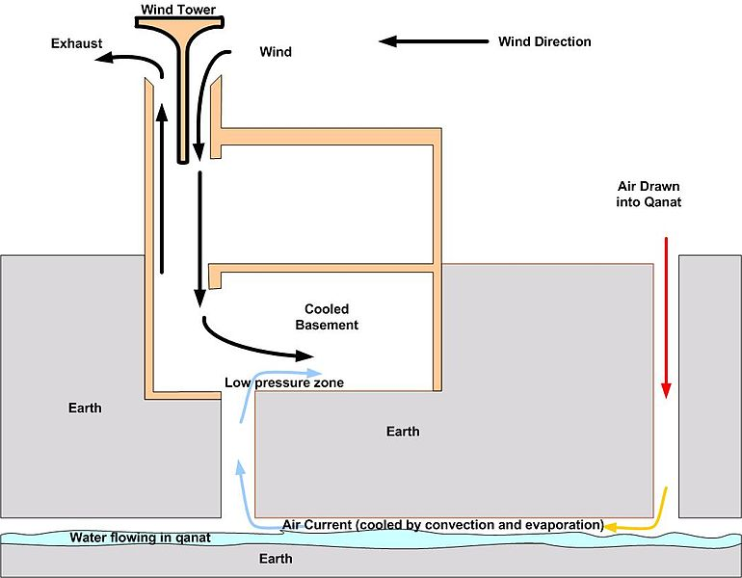
Problem Solving…
Monarchs Coolers (Agoura Hills only)
During The Summer Months We Use Evaporative Coolers
(It Cools Air, But Is Not Air Conditioning)
What Does That Mean?
It Means You Have To Turn It On When You Get In To the Gym…
How?
Open Rolling Door Knee
High Only
Flip The “On” Switch

Slide 18
Problem Solving…
No Waivers…No RSVP’s
STOP The Party
Seriously STOP The Party
No Waiver Means No Access To The Gym Floor
What If They Throw A Fit?
Stay Good-natured, But Be Confident In Our Policies.
Explain That Our Insurance Agency Does Not Permit Activity Without A Valid Liability Waiver.
If Aggressive Behavior Persists
Employ The Host Parent, They Are Aware Of Our Liability Waiver Policy When Booking A Party

Slide 19
Problem Solving…
Who Counts As An Extra Participant?
Anyone Who Is A Participant In Any And All Activities Taking Place On The Floor
People Not Participating In The Group’s Activities Are Not Allowed on The Floor
This would include older siblings/kids who want to do their own thing
Or younger siblings/kids with a parent who is off on their own
If They Are An Extra Child In The Lobby Or During Table Time, They Do Not Count As An Extra Child
Parents Are Not Allowed On The Floor To Socialize
They Should Stay In The Observation Areas

Slide 20
B-Day Closet…
Each Location Has A Birthday Party Closet
It Contains:
Table Settings
Cleaning Supplies
Birthday Medals
Other Birthday Party Necessities

Slide 21
How To Sign Up
Beckie will email you at the end of each month for your availabilty for upcoming weekends.
After the schedule has been set, Beckie will email out your schedule to you.
You must respond to the email to confirm that you have received your schedule.

