Slide 2
What do we do?
Inspiring #dynamickids To
Grow
Learn
Have Fun
Be Happy

Slide 3
Monarchs Mission Statement:
“Our mission at Monarchs is to cultivate a foundation of physical activity for future generations through body awareness and proper technique while developing a love for fitness and community from childhood.”

Slide 4
Customer Service
Monarchs Six Core Values

Slide 5
Monarchs Six Core Values
To provide the highest quality gymnastics instruction to children of all ages and skill levels.
To provide a fun and dynamic environment for children to stay active while building friendships.
To provide quality instruction and proper technique for street sports, Parkour, Xtreme and Cross Training.

Slide 6
Monarchs Six Core Values
To provide a basis for cheerleaders through stunting, motions, dance, and tumbling instruction.
To provide programs of value-added quality that are fun, convenient and hassle free.
To provide strong customer service and an ongoing commitment to excellence.

Slide 7
Employee Standards
Monarchs High Five’5

Slide 8
Monarchs High Five’5
Safety
Courtesy
Knowledge
Show
Efficiency

Slide 9
Monarchs High Five’5
Safety
I practice safe behaviors in everything I do.
I take action to always put safety first.
I speak up to ensure the safety of others.

Slide 10
Monarchs High Five’5
Courtesy
I project a positive image and energy.
I am courteous and respectful to customers of all ages.
I go above and beyond to exceed customer expectations.

Slide 11
Monarchs High Five’5
Knowledge
I have obtained the necessary information to do my job effectively.
I have a clear understanding of company brand standards.
I posses the necessary information to effectively communicate with customers and staff.

Slide 12
Monarchs High Five’5
Show
I stay in character and perform my role within Monarchs.
I ensure my area is show-ready at all times.
I understand that the show must go on.

Slide 13
Monarchs High Five’5
Efficiency
I perform my role efficiently so customers get the most out of their visit.
I use my time and resources wisely.

Slide 14
Monarchs High Five’5
Safety
Courtesy
Knowledge
Show
Efficiency

Slide 15
Office Staff
Provide Excellent Customer Service
In Person, On The Phone, Written Communication
Complete Class Manager Procedures Effectively, Accurately & Proficiently
Enrollments, Moves, Drops, Transfers, Sales, Etc.
Complete Office Procedures Effectively, Accurately & Proficiently
Enrollments, Moves, Drops, Transfers, Sales, Trials, Etc.
Keep Workspace Clean & Neatly Organized
Communicate With Manager On An Ongoing Basis
Be Committed To Work Schedule
Be A Team Player

Slide 16
Typography
Identifiable
Font
Nunito
Ariel Rounded Bold
www.monarchsgym.com
Use Of Space
Logo
Upper Left Hand Corner
Website
Bottom Center
Colors
White
Gray / Silver
Yellow
Black
*But they vary per location: X, HK, Mobile
Verbiage
Second Person Narrative
You, Your…
Upbeat & Friendly
Not Just Informative
We vs. I
Finger Pointing (2 vs. 1)

Slide 17
Agoura Hills
Newbury Park
Ukraine

Slide 18
Gymnastics
“One Sport
Of Many Disciplines That Challenges The Mind And Body As One”
A Great Foundation For Physical Activity

Slide 19
CB’s: Curriculum Based
“Inspiring Dynamic Kids
To Grow
Through Positive Instruction”

Slide 20
The Monarchs Method
Our Recreational Program Is Organized Into A Sequence Of Classes Following A Set Of Progressions, Based On A Solid Foundation Of Skills That Aid In The Essential Development Necessary To Progress Through The Program.

Slide 21
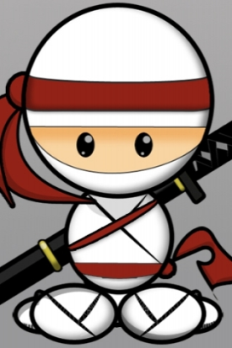
CURRICULUM
Monarchs Classes Are Taught According To A Theme
Each Theme Has A Class Focus
Nifty Ninja Class Focus:
Kicking, Jumping
Leaping, Tricking
SAFE LANDING IN PROGRESS
Rapid Raceway Relay
Class Focus:
Traversing Distance
Attaining A Goal
Teamwork & Speed
Safety Week
Class Focus:
Safety Falling
Safety Rolling
Safety Landing

Slide 22
KINDER GYM
The Monarchs Kinder Gym program is specifically designed to benefit your child’s growing development. Our safety and curriculum certified instructors teach life skills using gymnastics as a tool for math and reading readiness, gross motor skill development, as well as building confidence within group participation. Your child will build strength, flexibility and coordination in addition to spatial and perceptual awareness. They will utilize gymnastics apparatus (vault, bars, beam, floor, rings, ribbons; etc), props (balls, lumi sticks, hula hoops, bean bags; etc), and stations to master colors, numbers and lay a solid foundation for physical fitness and kindergarten prep. At Monarchs we let our imaginations soar so that your child’s imagination can too! Find a class today and let your child take their first step to a better future.

Slide 23
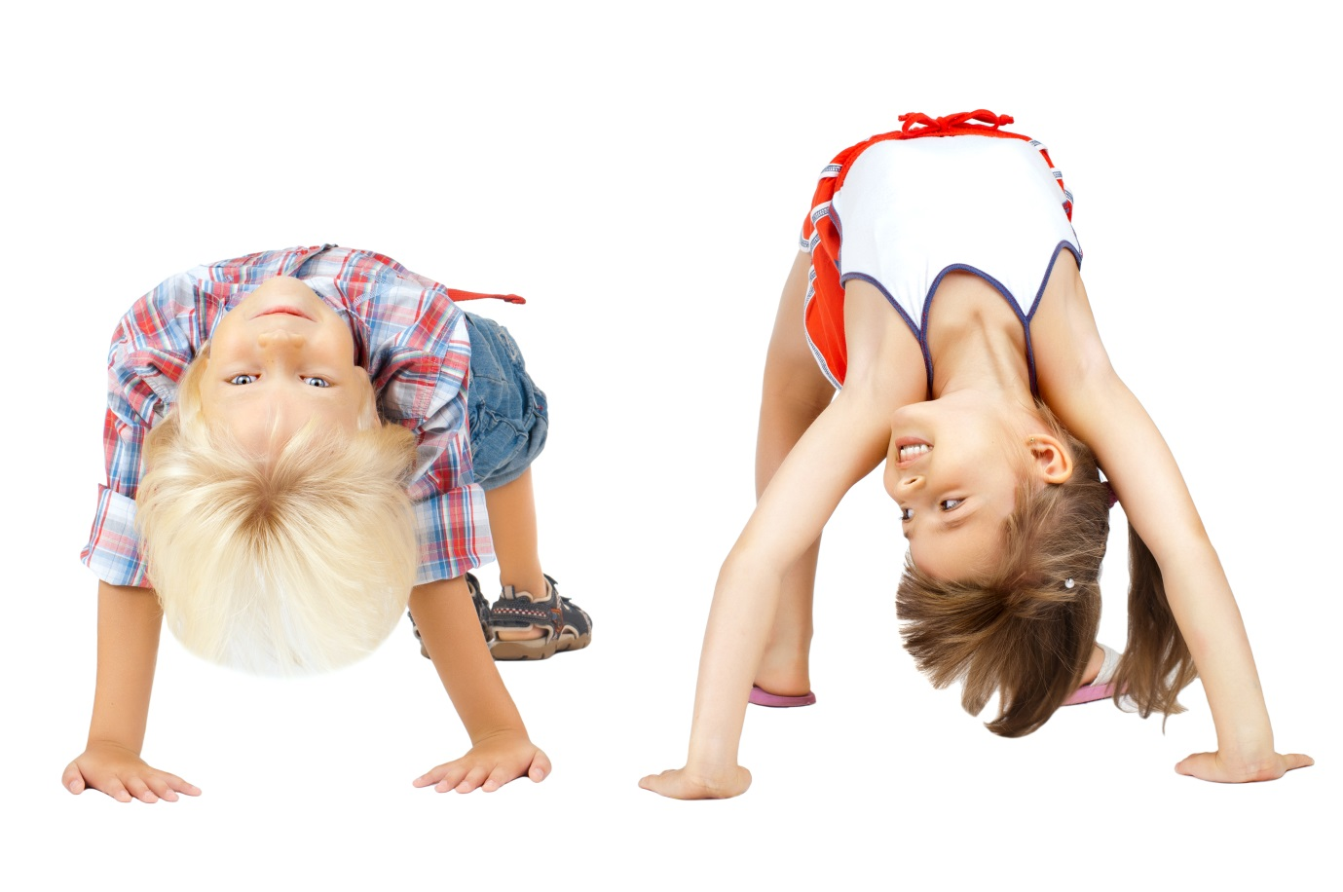
Kinder Program
Baby Developmental
0 – 15months
Parent / Tot
15months – 3yrs
Kinder I
2.5yrs – 3.5yrs
Kinder II
3.5yrs – 4.5yrs
Kinder III
4.5yrs – 6yrs

Slide 24
Kinder Recreational Gymnastics
The Monarchs Kinder Program Teaches:
“Gross Motor Skills”
Balancing
Bouncing
Bending
Crawling
Climbing
Curling
Catching
Galloping
Hanging
Hopping
Jumping
Kicking
Leaping
Lifting
Pushing
Pulling
Running
Rolling
Sliding
Shaking
Skipping
Stepping
Swaying
Stretching
Swinging
Twisting
Turning
Tumbling
Throwing
Walking

Slide 25
In Kinder: “We Utilize Gymnastics Skills To Teach Life Skills”
This Is Very Different Than Teaching Kinder Age Children Gymnastics Skills.
BUT…
That Doesn’t Mean That Children Who Take Kinder Classes Will NOT Learn Gymnastics Skills…In Fact They Will & They Do!

Slide 26
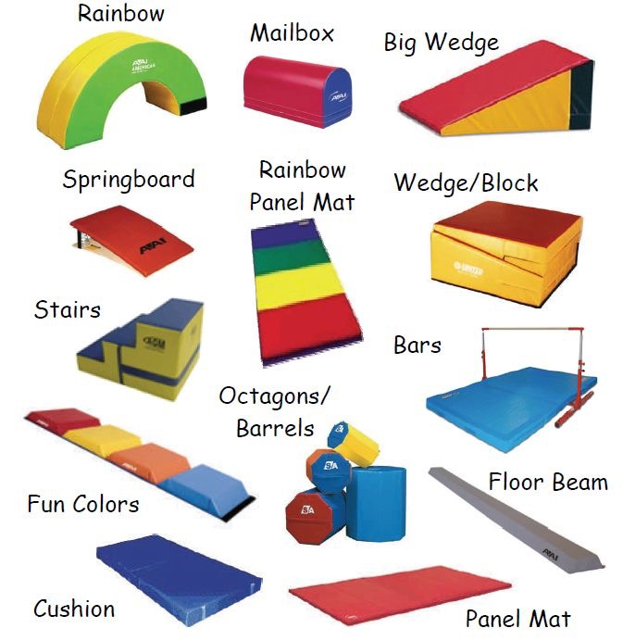
EQUIPMENT
Warm-Up
Vault
Bars
Beam
Floor Stations
Obstacle Courses
Relays
Games
Conditioning

Slide 27
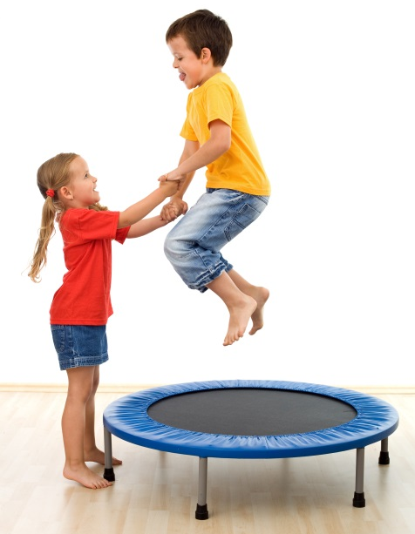
Why No Trampoline?
Neck – Spine Connection
Is not fully strengthened yet
Developing “Gross Motor Skills”
Body Control
Bouncing vs. Taking Flight
Feet never leave the trampoline
Feet leave the trampoline and
body control is required

Slide 28
The Monarchs Girls Recreational program is designed to foster the growth and aptitude of your child’s foundational gymnastics comprehension and ability. Our safety and curriculum certified instructors use gymnastics as a tool for physical development, gymnastics ability, as well as facilitating confidence, sportsmanship, courage, goal setting, time management and a myriad of additional psychosocial benefits. Your child will gain strength, agility, flexibility, and balance through gymnastics progressions and skill deconstruction. Artistic gymnastics students will utilize Vault, Bars, Beam and Floor as well as go through a warm - up and group conditioning sequence. Rhythmic gymnastics students will utilize the Rope, Hoop, Ball, Clubs, and Ribbon as well as go through a warm - up and group conditioning sequence. At Monarchs we aim to inspire your dynamic child to grow! Find a class today and see your child flourish.
Girls Recreational

Slide 29
Girls Recreational Gymnastics
Purple (Beginning Part 1)
6yrs – 8yrs
9yrs – 13yrs
Pink (Beginning Part 2)
6yrs – 8yrs
9yrs – 13yrs
Blue (Intermediate)
6yrs – 8yrs
9yrs – 13yrs
Green (Advanced)
Yellow (Pre-Xcel)

Slide 30
PURPLE The First Class In The Sequence
Vault
Running
Jumping
Board Drills
Bars
Front Support
Cast
Pull Over
Rope Climb
Beam
Walks:
Forward
Backwards
Sideways
Straight Jumps
Relevé
Floor
Body Positions
Pike
Straddle
Tuck
Straight
Rolls
Forward
Backwards
Bridge
Handstand
Cartwheel
Dance
Relevé
Arabesque

Slide 31
PINK The Second Class In The Sequence
Vault
Hurdle
Squat On
Pike On
Straddle On
Bars
Pull Up In Pike
Chin Up
3 Tight Casts
Swings In Tuck
Pull Up, Pull Over
Beam
Toe Raises
Coupé
Relevé Walk
Squat Walk, Squat Pivot
Lunge, Lever, Lunge
Floor
Jumps
Split
Tuck
Pike
Straddle
Backbend From Feet
Straddle Rolls
Cartwheel
Left & Right
Handstand Hold
Dance
Coupé Balance In Relevé
45°Arabesque
Kicks Across The Floor

Slide 32
BLUE The Third Class In The Sequence
Vault
Stag Runs
Handstand Fall Flat
Dive Rolls
Run, Hurdle, Punch, Stick
Repeat To Vault Table
Bars
Pull Up, Pull Over, 3 Casts, Cast Away
Jump Front Support, Cast Back Hip Circle
Glide Swing
Swing In Hollow
Beam
Relevé Pivot
Kicks:
Forward
Backward
Sideways
Straight Jumps
English Handstand
Floor
Bridge, Kick Over
Backbend, Stand Up
Pike Roll With Straight Legs
Front & Back
Cartwheel Snap
Handstand Hold, Forward Roll
Dance
45° Split Leap
Turn: Lock & Pivot
Turns: High Relevé
Assemblé

Slide 33
GREEN The Fourth Class In The Sequence
Vault
Sprint
Run, Hurdle, Punch, Handstand
Handstand Block
Front Tuck On Trampoline
Run, Hurdle, Punch, Front Tuck
Bars
Pull Up, Pull Over, High Bar
Squat On Floor Bar, Jump Off
Pull Up, Pull Over, Front Hip Circle, Cast Back Hip Circle, Underswing Dismount
Glide Kip
Beam
Turn In RelevéArabesque
Side Handstand Step Down
Tuck Jump
Floor
Backwalkover
Handstand Hold, Front Limber
Dive Roll
Power Cartwheel
Round-Off
Dance
90° Split Leap
90° Straddle Jump
Turns: Coupé
Assemblé Rebound

Slide 34
Yellow The Fifth Class In The Sequence The Final Class Before Competitive Xcel

Slide 35
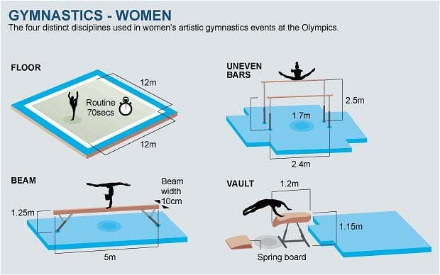
EQUIPMENT
Warm-Up
Vault
Bars
Beam
Floor
Conditioning
Games
Trampoline
& Foam Pit

Slide 36
The Monarchs Boys Recreational program is designed to foster the growth and aptitude of your child’s foundational gymnastics comprehension and ability. Our safety and curriculum certified instructors use gymnastics as a tool for physical development, gymnastics ability, as well as facilitating confidence, sportsmanship, courage, goal setting, time management and a myriad of additional psychosocial benefits. Your child will gain strength, agility, flexibility, and balance through gymnastics progressions and skill deconstruction. Your gymnastics student will utilize Floor, Pommel Horse, Still Rings, Vault, Parallel Bras, and Horizontal Bar as well as go through a warm - up and group conditioning sequence. At Monarchs we aim to inspire your dynamic child to grow! Find a class today and see your child flourish.
Boys Recreational

Slide 37
Boys Recreational Gymnastics
Boys 4/5*
4yrs – 5yrs
Beginning
6yrs – 8yrs
9yrs – 13yrs
Intermediate
6yrs – 8yrs
9yrs – 13yrs
Advanced

Slide 38
BEGINNING The First Class In The Sequence
Floor
Forward Roll
Backward Roll
Bridge
Candlestick
Rings
Swing Forward
Swing Backward
Pull Up Hold
Vault
Fast Run
Correct Board Jump
Squat On Drill
Straddle On Drill
Parallel Bars
Swing Forward
Swing Backward
Horizontal High Bar
Swing Forward
Swing Backward

Slide 39
INTERMEDIATE The Second Class In The Sequence
Floor
Handstand (Hold)
Handstand Forward Roll
Bridge
Cartwheel (R/L)
Pommel Horse
Scissors Swing
Rings
Pull Up Hold
“L” Hold
Swing Forward
Swing Backward
Vault
Fast Run
Correct Board Jump
Squat Through Drill
Straddle Through Drill
Parallel Bars
Swing Forward
Swing Backward
Swing Backwards With Dismount
Horizontal High Bar
Swing Forward
Swing Backward
Pull-Over
Cast, Back Hip Circle

Slide 40
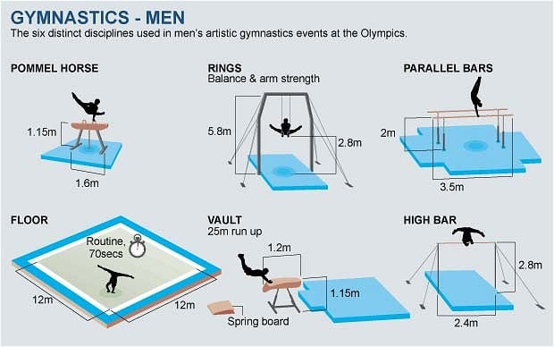
EQUIPMENT
Warm-Up
Floor
Pommel Horse
Rings
Vault
Parallel Bars
Horizontal High Bar
Relays
Games
Conditioning

Slide 41
The Monarchs Tumbling & Cheer program is strategically developed to provide students with essential skills necessary to promote their tumbling and cheer proficiency. Our safety and curriculum certified instructors use tumbling techniques and fundamental cheerleading practices for performance readiness, bi-lateral motor skill development as well as increasing balance, coordination, flexibility, agility, strength, and determination in students. Your tumbler will utilize the floor, tumble track, trampoline, long trampoline, and foam pit to master tumbling skills from beginning to advanced. Your cheerleader will learn basic motions, jumps, and stunts; they will master dance techniques and routines as well as essential tumbling skills. The Monarchs Tumbling and Cheer program is suited to a variety of ages and skill sets and aims to get you ready for All-Star and High School cheer or as a supplement to your dance pursuits. Find a class today and blow your competition out of the water when you need to!
Tumbling & Cheer

Slide 42
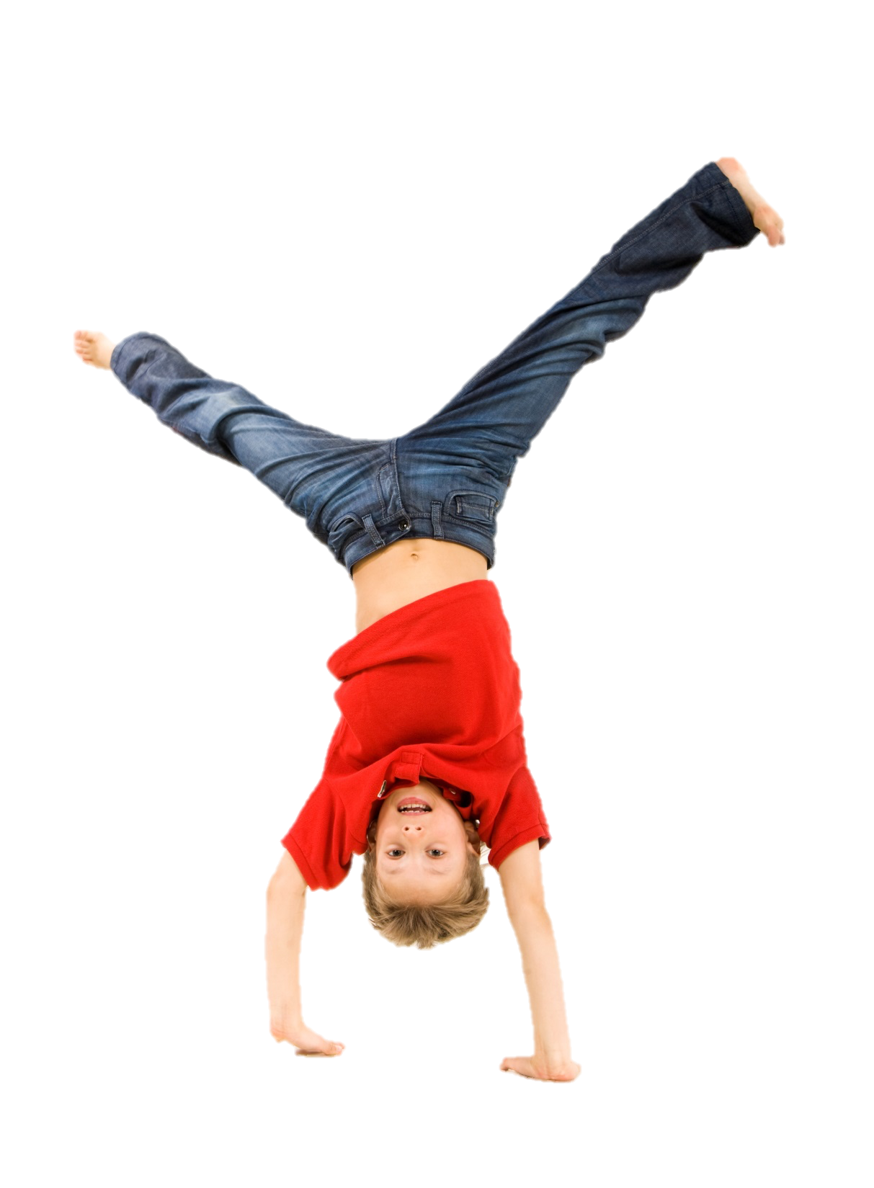
TUMBLING & CHEER
Youth Intro
6yrs – 9yrs
Intro
9yrs+
Novice
Skill Req.
Expansion
Skill Req.

Slide 43
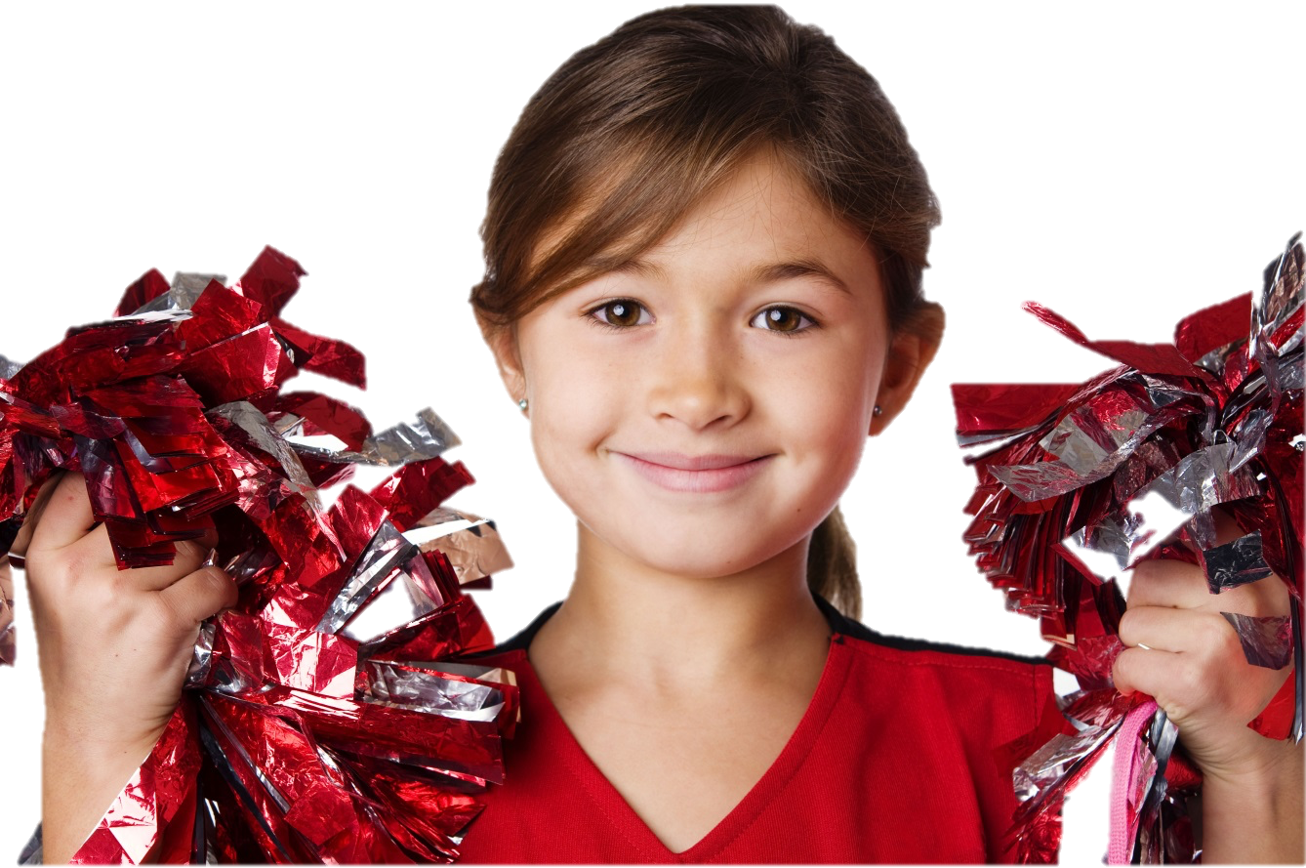
CHEER
This is a great program for those interested in getting into all star cheer!
Basic Arm Motions
Basic Formations
Basic Tumbling
Jumps
Leaps
Stunts

Slide 44
The Monarchs Active program was developed exclusively to promote the advancement and development of dynamic and active kids. This incredible program offers your child a variety of courses to meet their active lifestyle and compliment a variety of sports. Choose a class that benefits a specific sport or try a class just for fun, whatever the reason, there is a Monarchs Active class just right for your child. Flips & Tricks, Breaking, Parkour, Stunting, X-treme Sports, Dance, Trampoline and more! Find a class today and help your active child grow by leaps and bounds! *Class offerings vary monthly.
Active Program

Slide 45
Active Programs
Ninja
WonderGirl
Flips & Tricks
Parkour
Xtreme Sports
Trampoline
Breaking
Adult Fit

Slide 46
What is Parkour?
Getting From Point “A” To Point “B” In A Fluid Motion using rolling, vaulting, climbing, jumping, traversing, and landing while maneuvering over obstacles.
MonarX Parkour Program
Is Organized Into A Sequence Of Classes Following A Set Of Progressions, Based On A Solid Foundation Of Skills That Aid In The Essential Development Necessary To Progress Through The Program.
The Sport Originated In France… Therefore Our Class Names Are In French
Fondamental
Intermédiaire
Avancé

Slide 47
PARKOUR SKILLS (6yrs+)
Rolling
Vaulting
Climbing
Jumping
Landing
Falling
Sport Specific Drills

Slide 48
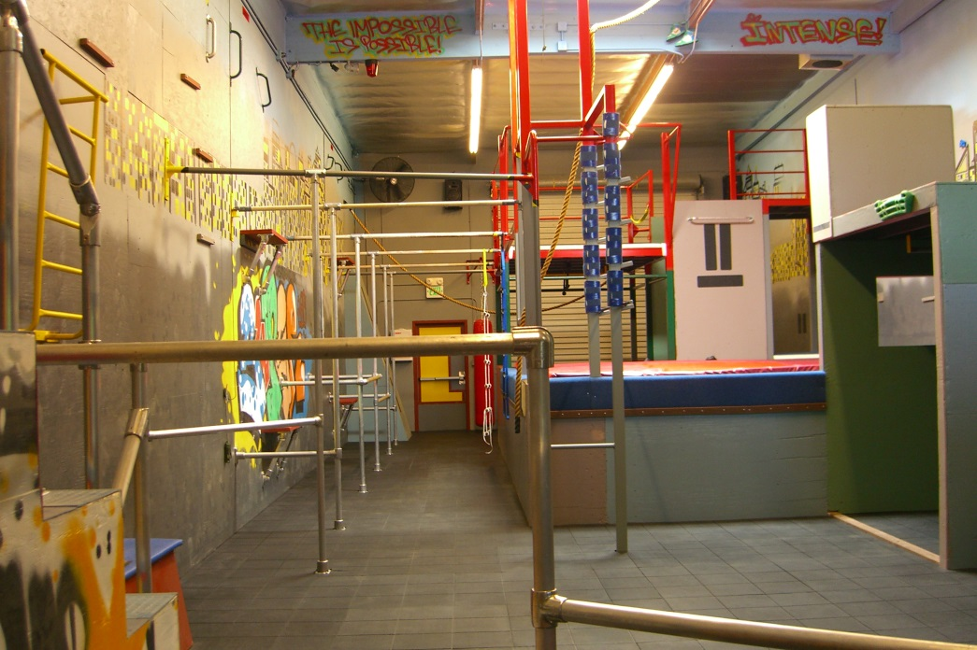
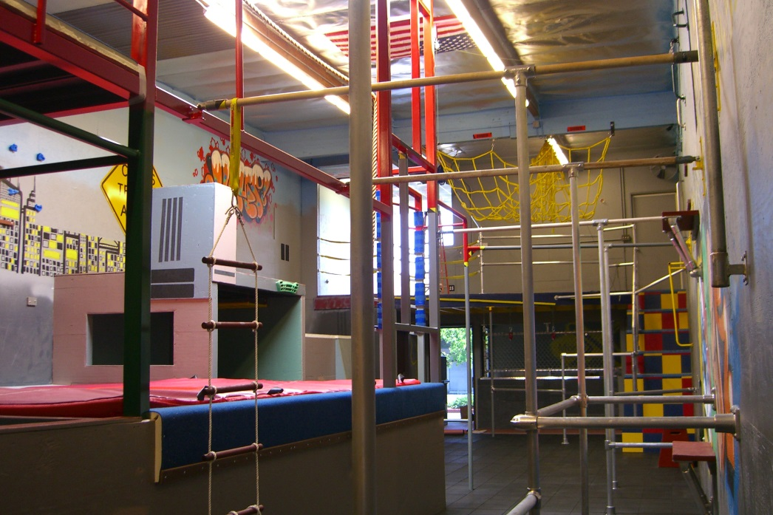
EQUIPMENT
Bars
Rails
Pit
Re-Grip Stations
Climbing Walls
Blocks
Stairs
Obstacle Course

Slide 49
NCB’s: Non-Curriculum Based
“Inspiring Dynamic Kids To Have Fun”

Slide 50
Birthday Parties
Day Camps
Parents Night Out
Field Trips
Facility Rentals

Slide 51
Why Is Monarchs Camp Awesome? The main reason Monarchs camps are amazing are…
Every 15 minutes activities change, maximizing attention & focus,
Flexible schedule for parents to customize their camp schedules,
Variety of camp options to choose from,
Gymnastics instruction , games, relays, etc, etc, etc

Slide 52
Parent’s Night Out & Open Gym
Parent’s Night Out
Check For Specific Times & themes At Your Location
7pm – 10:30pm (Fri AH)
6pm - 9:30pm (Sat AH)
5:30pm – 9pm (Fri NP)
Pizza & Drink Included
Warm-Up
Games
Open Play
Obstacles
Etc…
Open Gym
Check For Specific Times At Your Location
Warm-Up
2 Specific Stations
Coach Acts As Facilitator
No Class Curriculum
Therefore, NOT ideal for learning new skills
But, great for perfecting skills you already have

Slide 53
Monarchs Mobile Gym
Mobile Gymnastics
Preschools
After school programs
Parks, etc.
Eventually
Birthday Parties
Monthly Billing
Autopay

Slide 54
Preschool inside Suite “C” of Monarchs Agoura Hills
Miss Beckie is the Director
Boutique style Preschool with limited space
9-12, 12-3, or 9-3 options
Monthly Billing & School Year Calendar
Adheres to State rules & policies for Preschool procedures.
Monarchs Happy Kidz Preschool, founded in 2015, inspires dynamic children to learn through creatively enriching, academically stimulating, and physically challenging daily learning units all in a nurturing environment with small class sizes.

Slide 55
Personal Presentation
Image
Dress Code
Hair
Grooming
Body Language
Facial Expression
Slouching
Sitting
Tone Of Voice
Energetic
Up Beat
Commanding

Slide 56
Customer Service: “Customer service is a series of activities designed to enhance the level of customer satisfaction – that is, the feeling that a product or service has met the customer expectation."
Do’s:
Being attentive to any customer at the window or on the phone.
Making the customer your priority.
Making sure that the customer always feels like you really want to help them.
Don’ts:
Not getting them off the phone as soon as possible, not sighing, rolling your eyes or showing your attitude and making them feel like they are the last person you want to be talking to.

Slide 57
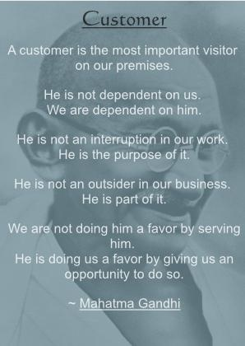

Slide 58
Get Physical… Office
When a customer is at the window, get up when speaking with them.
Don’t talk to them from the chair…it’s not consistent with the Monarchs brand.
Every single child that has a question, every parent that doesn’t know their way around the gym, anyone who needs a tour of the gym, to know who their coach is, whether it be their class or a make-up, the office MUST physically show the customer around & where to go.

Slide 59
Get Physical… Coaches
When a customer is watching you coach their children from the window or sidelines…what they see is sometimes different than what you experience as a coach.
Sitting while coaching is not ACTIVE coaching…and it could result in prolonged response time to a child in need.
Things like waiving your fingers, shaking your head…all look very different from a window ☺

Slide 60
Daily To Do List (Office)
Tasks
Communication
The Daily To Do List Is Crucial.
It Keeps The Day To Day Operations Going:
Trials
Office Books
Coaches Books
Balances
Waivers
Etc
Communication is the most important part of working in the office.
Conveying the correct message to a customer could be what makes or breaks a Trial or Sale.
Communicating with a Manager regarding tasks accomplished or not yet completed is imperative!

Slide 61
Daily To Do List: Coaches
Check in with the office
Check in with your director
Know the theme & focus
Call the class with enthusiasm
Take attendance
Follow the curriculum
Parent teacher interaction at the end of class

Slide 62
Professional Attire
Monarchs is the gymnastics leader in the communities we serve and our employees are expected to reflect that leadership. For this reason, the professional appearance of our employees is of utmost importance. We take great pride in the way you represent Monarchs. Your personal grooming and attire should always reflect a professional image.

Slide 63
