Slide 1
Safety & Risk Management
“fear of harm ought to be proportional not merely to the gravity of the harm, but also to the probability of the event.” ~ Daniel Bernoulli

Slide 2
Why Certification?
Helps prepare for the future
Enhances professionalism
Increases awareness of safety issues and injury needs

Slide 3
Catastrophic injury trends

Slide 4
Safety Guidelines
Properly plan the activity
Includes lesson and training plans for class, practice and competition; skill progressions; conditioning and fitness programs; warm-up activities; ample rest and recovery time. Using well-prepared plans allows maximization of training time with athletes, helps to avoid downtime or horseplay, and aids with proper athlete development.
Supervise the activity appropriately
Incudes being present, watching the activity and all athletes within your care, controlling the situation through knowledge and planning, and ensuring safety measures are important. Supervision begins when the athlete enters the facility, continues through practice until the athlete leaves the property.

Slide 5
Safety Guidelines (Cont..)
Provide proper instruction/coaching
Gymnastics professionals should know the skills and movements they are teaching, as well as the progressions and lead-ups for those skills and properly instruct the students in those activities. Proper instruction also includes continual review of safety practices, such as falling and landing drills, repetition and fundamental skills, demonstrations of correct skill technique, and ample practice time.
Provide a safe physical environment
Facilities should be safe and free from hazards. Establish a plan for regular inspections and maintenance. Environmental considerations may also include air temperature, moisture and humidity or other factors that would require special considerations.

Slide 6
Safety Guidelines (Cont..)
Provide adequate and proper apparatus and equipment
Apparatus and equipment should be inspected prior to each use. Ensure apparatus/equipment is secure, mats are properly placed and there are no obstacles in the way. Avoid modifying apparatus or equipment and using it for activities other than intended purpose.
Educate regularly
Gymnastics professionals should continually educate athletes and other participants regarding appropriate and safe behaviors. Education should be done regularly and be presented in a written and oral form.

Slide 7
Safety Guidelines (Cont..)
Provide appropriate emergency assistance
Gymnastics professionals are expected to know what to do if an injury occurs. Knowledge of basic first aid, injury management procedures and how to implement the emergency action plan are important.
Keep informed
Regularly updating knowledge of gymnastics skills, proper technique, skill progressions and drills, rule changes, safety issues, and major health guidelines among others is essential for gymnastics professionals.

Slide 8
Safety Guidelines (Cont..)
Know the gymnasts
Gymnastics professionals should consider a variety of factors, such as age, height, maturity, skill level, experience, and emotional state, in determining what skills, drills, and teaching activities are appropriate for the athletes and at what level and intensity. Other key information to know includes athletes’ names, medical status and longevity in the program.
Keep records
Keep records of what takes place in the program and at events. Records should include written lesson/training plans, emergency action plans, incident reports, progress reports, inspection and maintenance checklists, student files with contact and medical information, waivers and releases and other notes and forms.

Slide 9
Unit 1 Quiz
Which of the following is not one of the basic steps for the gymnastics professional in preparation for teaching and/or coaching?
Provide appropriate emergency assistance
Know the gymnasts
Have detailed knowledge of the gyms insurance policy
Keep informed
Safety practices such as participating in continuing education and providing adequate equipment are part of a well-managed gymnastics program as well as qualities of a good gymnastics coach.
TRUE
FALSE

Slide 10
Unit 1 Quiz
Which of the following is NOT one of the purposes of Safety/Risk Management Certification?
Increase awareness of safety issues
Enhance professionalism
To learn how to teach gymnastics skills
Prepare for the future
Why do gymnastics professionals need safety certification?.
Teach elite level skills
Diagnose and treat injuries
Increase safety awareness and help prevent injuries
Complete all education needed in the sport of gymnastics

Slide 11
Unit 1 Quiz
Which if the following employees should be educated in the area of risk management?
Cleaning personnel
Office manager and assistants
Instructors and coaches who work more than two hours per week
All of these employees should receive risk management education

Slide 12
Section 1: Risk Management
“Each problem that I solved became a rule which served afterwards to solve other problems.” ~ Rene Descartes

Slide 13
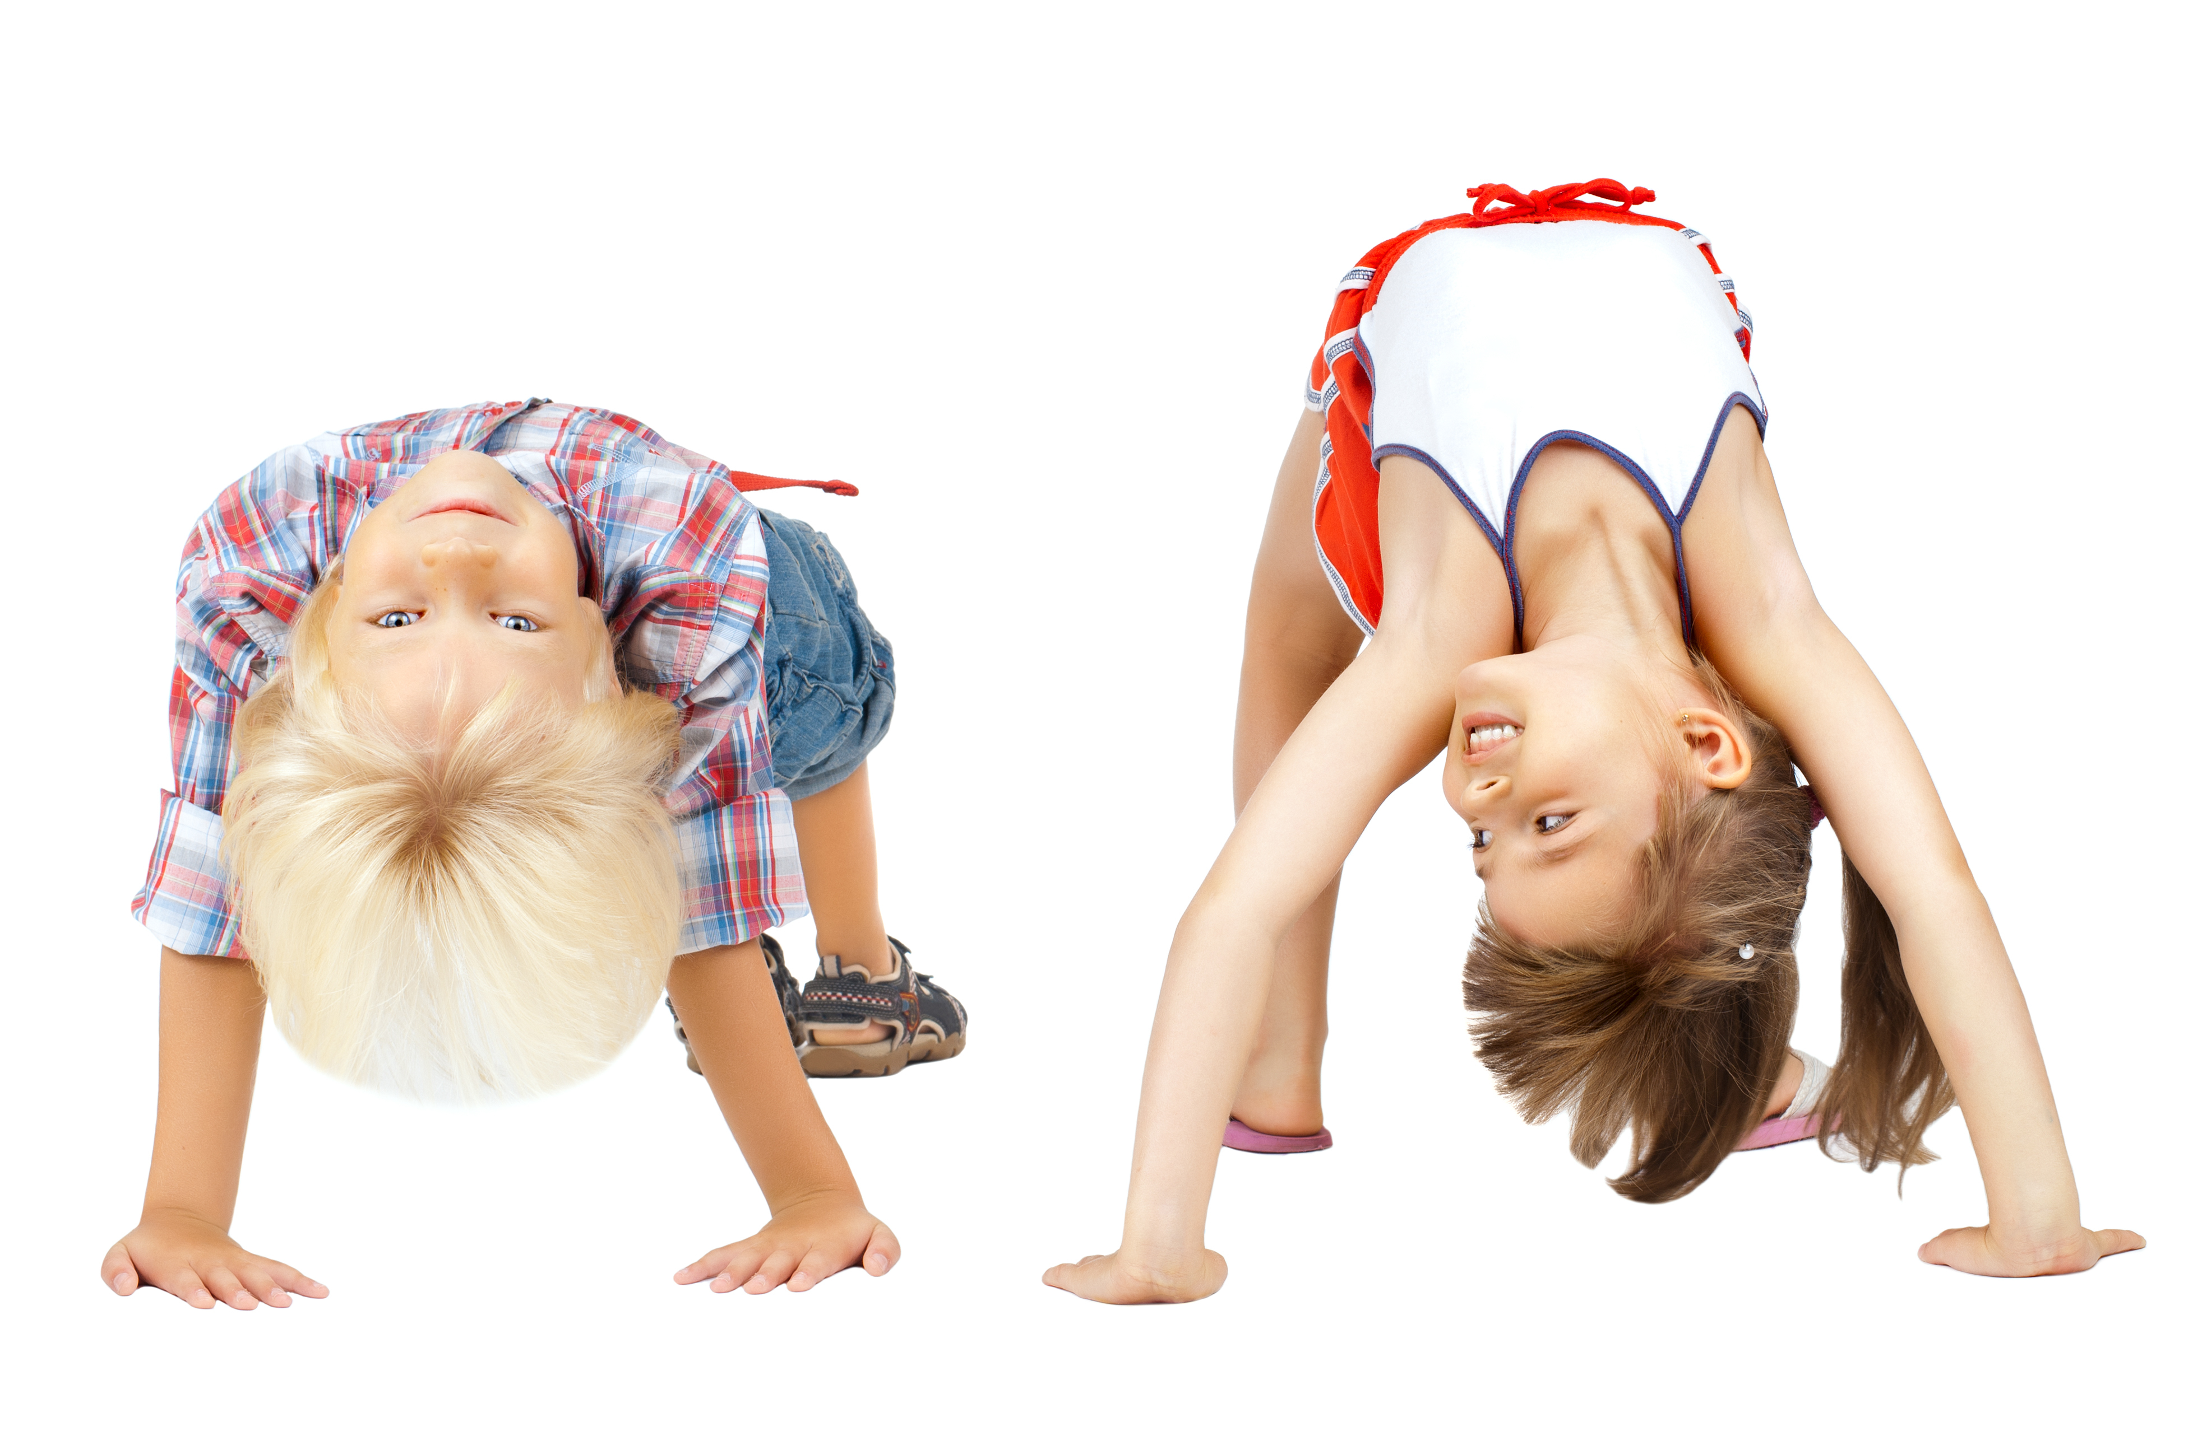
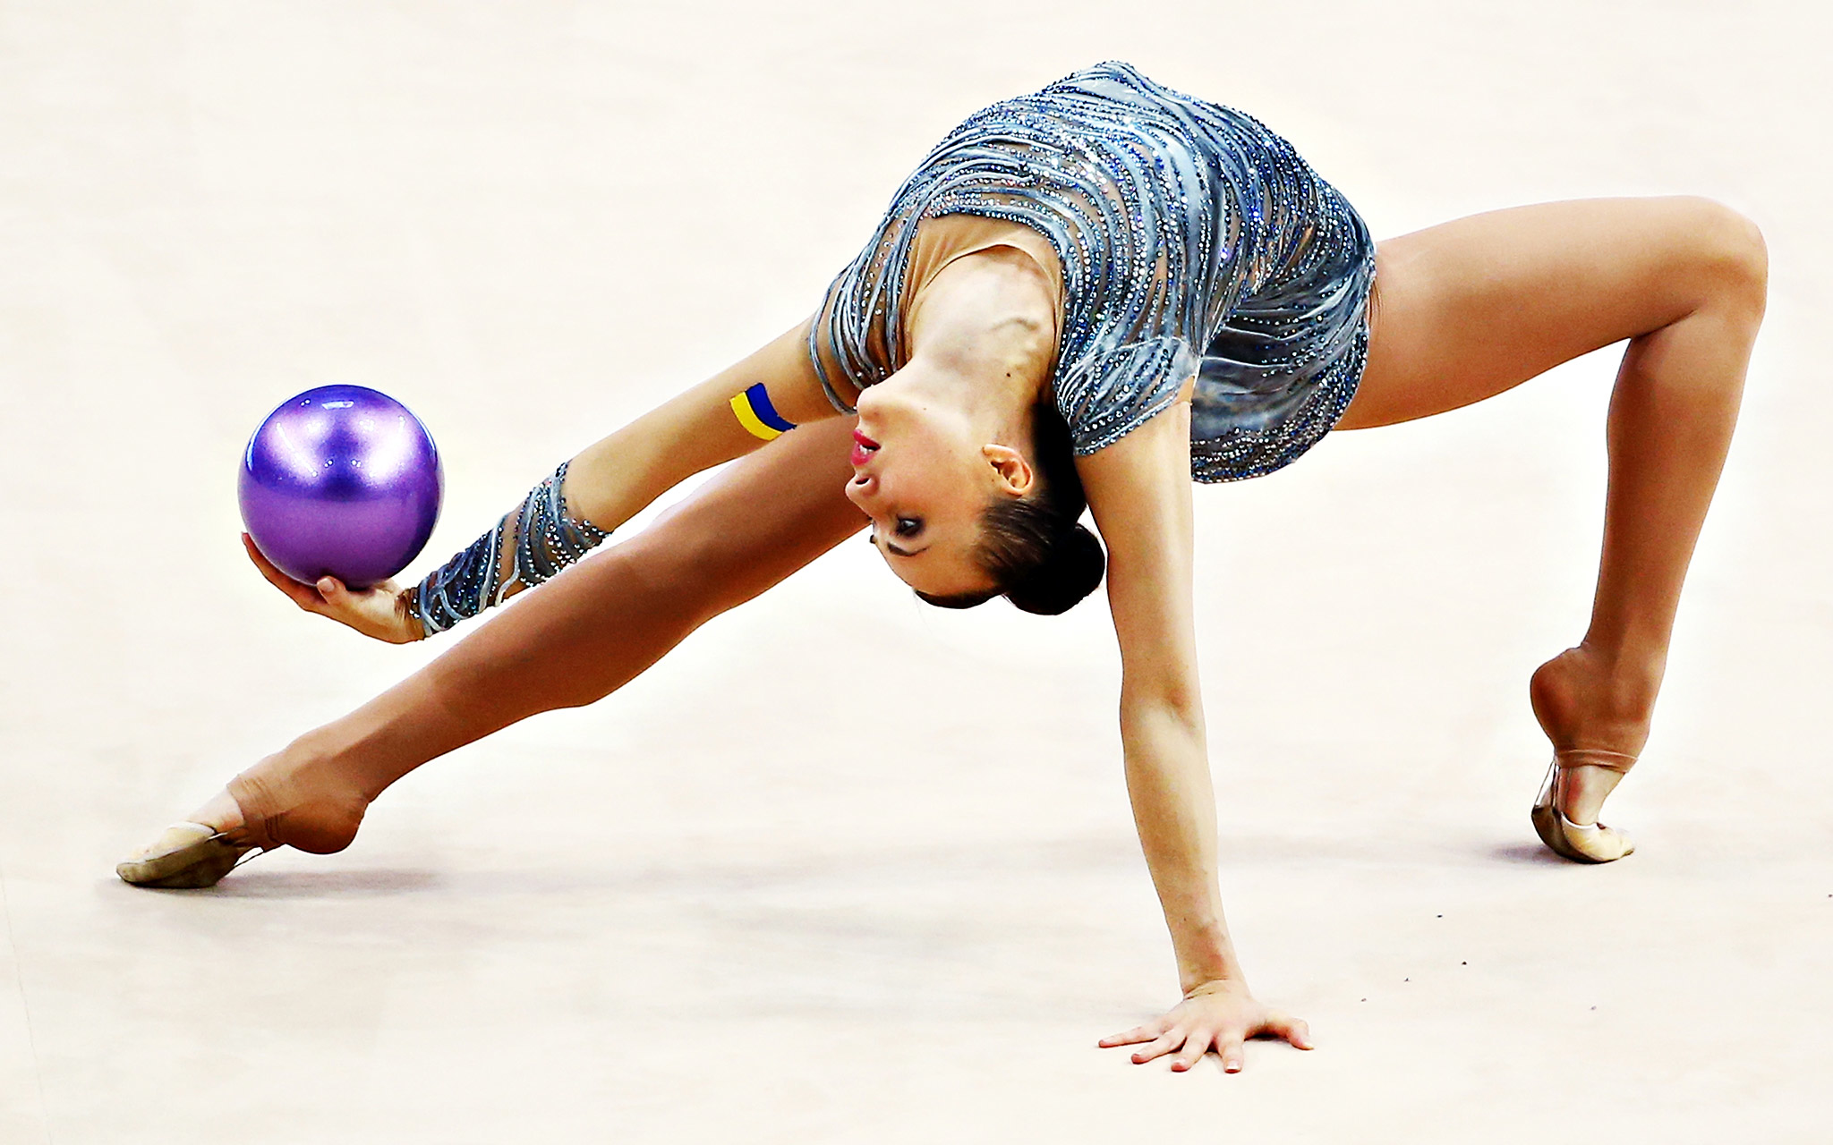
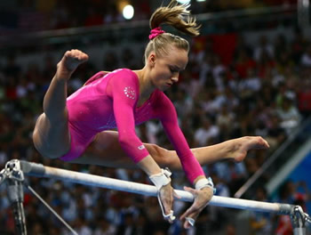
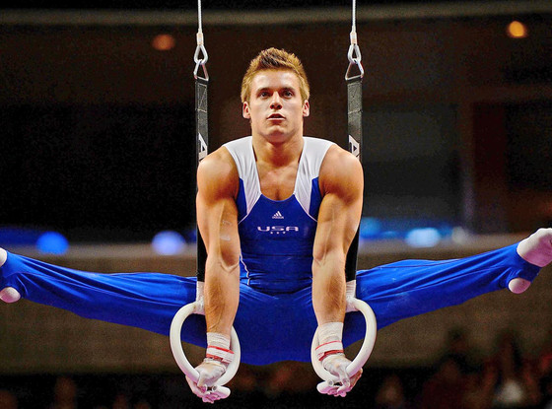
This is “Gymnastics”

Slide 14
Practical approach to safety education is…
RISK MANAGEMENT

Slide 15
Risk involves danger, hazard, peril and chance
What things can happen?
What is the likelihood of them happening?
What is the consequence if they do happen?
Areas of Risk:
Injuries
Lawsuits

Slide 16
Risk + Management __________________
What Is Risk Management?
It’s all about…PREVENTION
Safety and Injury
Prevention

Slide 17
Risk Management is a process, not an OUTCOME
Risk Management is a method for identifying risks and developing and implementing programs to protect against those risks.

Slide 18
Goals of risk Management
Risk management seeks to:
Inform
Educate
Inspire
Gymnastics professionals to understand and control areas of risk.

Slide 19
Effective risk management
Assess:
Monitor:
Identify,
Analyze,
Prioritize potential risks
The results and
revise as necessary
Select:
Implement:
Methods to prevent injury and loss and develop the plan
The plan

Slide 20
Key points
Risk management is an approach to safety education.
Risk management is necessary because gymnastics carries inherent risks.
Through risk management the gymnastics professional hopes to reduce injuries.
Risk management is a process and not an outcome.
Risk management is a method of identifying risks and implementing programs to protect against those risks.
The job of a gymnastics coach or instructor is a difficult one.
Gymnastics professionals need to be knowledgeable and dedicated.

Slide 21
Unit 2 Quiz
Risk involves which of the following?
Danger
Peril
Hazard
All of the above
What is the primary area of concern (risk) in gymnastics?
Risk of a lawsuit
Risk of an injury
All of these
Risk of losing

Slide 22
Unit 2 Quiz
What are the four basic steps of a risk management process?
Rest, ice, compression, elevation
Airway, breathing, circulation, CPR
Assess, select, implement, monitor
Duty, breach of duty, cause, damage
Risk management is NOT a means of safety and injury prevention?
TRUE
FALSE

Slide 23
Unit 2 Quiz
Complete the following sentence. Risk management is a process…
For training staff
None of these
For coaching optional gymnasts
Not an outcome

Slide 24
A model of risk management
“The purpose of models is not to fit the data but to sharpen the questions.” ~ Samuel Karlin

Slide 25
Assess ~ Select ~ Implement ~ Monitor
Models: are used to simplify things and make complex concepts more understandable

Slide 26
Assessment
Identify:
Look closely at all aspects of the gymnastics program
Analyze:
Gather and process data to help understand the likelihood, severity and frequency of an injury or incident
Prioritize:
Organize and address according to significance

Slide 27
Assessment: Staffing
Staffing requirements should consider:
Number of personnel needed to operate safely
Hiring plans and policies
Applicable regulations
Staffing assignments should consider:
Instructor/coach : athlete ratios
Areas and levels of expertise
Supervisory roles
Staff members should:
Be competent
Have current certifications
Receive “green light” on background checks
Comply with laws and regulations
Know their areas of responsibility
Participate in continuing education

Slide 28
Assessment: policies & procedures
Gymnastics professionals should teach, and constantly reinforce, safety policies and procedures. Administrators, instructors, coaches, judges, and meet directors should do all they can to ensure that safety rules are followed.

Slide 29
Assessment: Organizational Culture
Gymnastics culture can be thought of as the “tone” or “character” of a program.
AVOID ABUSIVE CULTURES

Slide 30
selection
Research:
Understanding management and control methods
Determine:
Techniques most appropriate for each risk
PLAN

Slide 31
Selection
Risk management & control techniques include:
Policy and procedure development
Staff education
Emergency action plans
Supervision
Removing or eliminating hazards
Risk transfer (e.g., insurance, legal forms)

Slide 32
implementation
Include written plans and checklists
Occur before activities begin
Educate and communicate the plan
Follow the plan
Practice, monitor and record the plan
Involve the safety team
ACTION

Slide 33
Implementation: written plans
Plans should be:
Written
Distributed
Constantly available
Reviewed
Explained
Reinforced

Slide 34
Implementation: Safety Team
Method of implementation
Increase safety awareness
Aware of activities
Safety needs
Injuries
Administration
Could include administrators, coaches, instructors, athletes, parents, medical personnel

Slide 35
Implementation: communication
Safety team communications should include:
Parents & Public should be informed of:
Latest information on injury trends
Safety measures
Rehabilitation techniques
Athlete idiosyncrasies
Apparatus & equipment specifications
Purpose and goals of the gymnastics program
Inherent risks and reasons for safety rules
Basic information about identifying, preventing and caring for injuries

Slide 36
Goal + Instruction + Repetition __________________
Implementation: Practice
Using your “common sense” may be a good way to maintain good judgment in new situations.
Common sense is developed through knowledge, experience, and observation.
PRACTICE

Slide 37
Implementation: Practice
Practicing procedures helps:
Identify flaws in the plan
Give everyone a chance to be involved
Ensure that if an injury occurs, appropriate steps are taken
Ensure all staff and participants know what to look for

Slide 38
monitoring
Evaluation Includes:
Feedback from assessments, safety team and others
Preseason, postseason or “off season” reviews
Reviews following special events (e.g., meets, shows, camps)
Maintain Records:
Used to determine the effectiveness of safety plans and their implementation
Adaptability
Continue to revise and improve plans as needed
RESULTS

Slide 39
Key points
Risk management can easily proceed from a model that involves assessment, selection, implementation and monitoring.
Assessment involves identifying, analyzing and prioritizing risk throughout all aspects of the gymnastics program.
The selection phase is when the plan is formally developed.
Implementation should involve rich communication and education, occur well before activities begin, engage a safety team, establish policies and procedures in writing, and afford practice in safety plan implementation.
Success of the risk management process is dependent upon continual review and evaluation with changes being made as needed.

Slide 40
Unit 3 Quiz
Who should be included as part of the “safety team”?
Only coaches and instructors
Club owners, coaches and instructors, judges, athletes and parents
Only club owners
Coaches and athletes
The “Selection Phase” involves developing the plan for managing risks.
TRUE
FALSE

Slide 41
Unit 3 Quiz
Gymnastics “culture” can be thought of as the tone or character of a program. Which of the following cultures could lead to greater risk and potential for injuries?
Learning correct gymnastics skills
Gymnastics is fun
Every child is a star
Win at all costs
Assessing a gymnastics program for risks includes which of the following aspects?
All of these aspects are involved with assessment
Analyze risks
Prioritize risks
Identify risks

Slide 42
Unit 3 Quiz
Continually scrutinizing the results of the plan and making adjustments as needed is part of which phase in the risk management process?
Monitoring
Assessment
Selection
implementation

Slide 43
facilities
“Order is never observed; it is disorder that attracts attention because it is awkward and intrusive.” ~ Eliphas Levi

Slide 44
The Facility: Refers to the building and grounds of the gymnastics program
The facility is one of the most important and controllable factors in risk management
Includes:
The building itself
External areas and grounds
Gym areas
Locker rooms
Rest rooms
Observation areas
Offices
Other ancillary areas

Slide 45
Who is visiting the facility?
Only those individuals educated about the safe use of the apparatus/equipment and have signed appropriate documentation, such as athletes or other participants, should use the apparatus/equipment.
Examples of individuals who may enter a gymnastics club:
Athletes
Participants in order activities
Coaches, instructors, and other staff
Parents
Friends and family members
Spectators
Potential clients
Individuals who may wander in off the street

Slide 46
hazards
Hazards are causes of danger
Facility hazards usually come from:
Poor planning & design
Poor facility management
(Hazard caused by untidy mats, causes of trips, slips and falls)
(Hazard caused by mats blocking the exit door)

Slide 47
Poor planning & design
Common design and planning problems in gymnastics facilities include:
Inadequate safety zones around apparatus and performance areas
Poor pedestrian traffic flow
Lack of proper storage space
Inappropriate building materials
Standard glass walls near activity areas

Slide 48
Poor Facility Management
Examples of poor facility management include:
Broken glass
Water on the floor
Equipment (out of place) blocking a pathway
A blocked exit door
Slippery sidewalks due to ice
Uneven surfaces that may cause tripping
Safety problems due to poor facility management, particularly poor maintenance, are estimated as the #1 complaint in facility related injury litigation.
It is every employees responsibility to aid in the maintenance of a facility.

Slide 49
Identifying Hazards
Facilitates should be inspected for hazards each day before commencing activities.
Apparatus and equipment should be inspected by the instructor or coach prior to each usage.
Identifying hazards and taking corrective action are the major goals of facility risk management.

Slide 50
Taking action
Eliminate the hazard (most desirable)
Replace broken glass, wood, or building materials; fix a source of leaking water or dry the floor
Eliminate exposure to the hazard (usually temporary measure)
Placing a “do not use” sign on a damaged door

Slide 51
Facility risk management process
Assess risk regularly
Identify potential risks the facility may present
List and prioritize identified hazards
Plan periodic inspections
Develop inspection checklists
What and when to inspect, how often, by whom, procedures for repair
Implement preventative measures
Ideally, maintain/repair something before it breaks
Include cleaning, disinfecting, lubrication, testing, and replacement of signage
Monitor facility risk controls

Slide 52
Safety education & Rules
Staff & Participant Education: Staff Should
Be aware of unique characteristics and potential hazards
Help to identify hazards that may arise and communicate those with appropriate supervisor
Safety Rules: Include
Establishment of rules regarding the safe use of the facility
Communication of those rules to staff and participants – through education and signage
Enforcement of the rules

Slide 53
Events & facilities
Event plans should consider the following:
Unique factors of public assembly facilities
Local special use permits ad zoning ordinances
Ticket sales and entrance enforcement
Contestant services, accommodations and security
Hospitality areas and liquor liability
Operations – crowd control
Site management – construction, electrical, maintenance and signage
Concessions – licenses and taxes
Support services – health and safety, communications, traffic control, transportation and parking
Cash management

Slide 54
Key Points
The facility is one of the most important and controllable factors in risk management.
Only athletes or participants who have been educated about the safe use of the apparatus / equipment and have (along with parents) signed appropriate documentation should be allowed to use the apparatus and equipment.
Hazards are dangers.
The goal of facility risk management is to identify hazard and take corrective actions.
Facilities should receive routine assessments, inspections and maintenance.

Slide 55
Key Points (cont.)
Staff and participants should be educated and informed regarding specific safety issues for each facility.
The facility can be divided into: (a) external areas and grounds, (b) the building, and (c) ancillary areas. Each area has unique characteristics that require specific inspection, maintenance and review policies and procedures.
Gymnastics events, whether in your facility or in a public facility, require the same kind of safety planning and vigilant use as other gymnastics facilities, as well as additional considerations.

Slide 56
Unit 4 Quiz
What is one of the most important and controllable factors in risk management?
Lawsuits
Enrollment
Facilities
Official's Scores
Which of the following is considered part of the “facility”?
External grounds
The gym area
All of these are considered part of the facility
offices

Slide 57
Unit 4 Quiz
Who should be allowed to use the apparatuses and equipment?
Anyone who has paid tuition
Siblings of registered athletes who are potential new customers
Only participants who have been educated about he safe use of the apparatus / equipment and have (along with parents) signed appropriate documentation
Staff and athletes with experience

Slide 58
Unit 4 Quiz
When a hazard is identified, what steps should be taken?
Ignore he hazard
Eliminate the hazard or exposure to the hazard
Complain to a fellow coach
None of the items listed
Staff and participants do not need specific education regarding unique safety issues for the facility?
TRUE
FALSE

Slide 59
Gymnastics apparatus & equipment
“duct tape is like the force. It has a light side, and a dark side, and it holds the universe together.” ~ Carl Swanzig

Slide 60
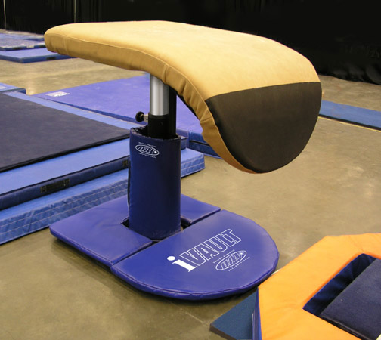
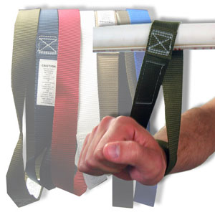
Gymnastics injuries usually involve gymnastics apparatus & equipment
Apparatus are those items used directly for competition
Equipment are those items used for all other purposes, such as teaching progressions

Slide 61
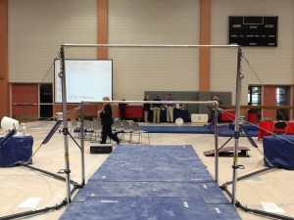
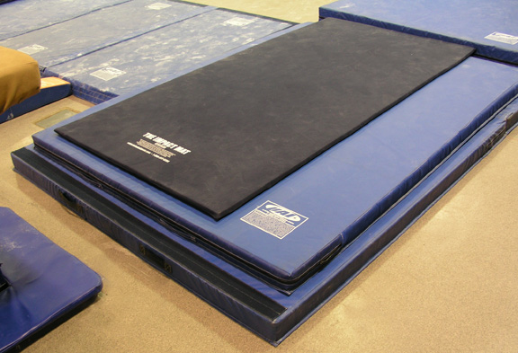
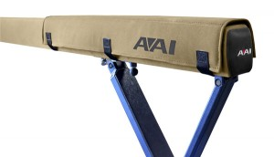
Apparatus and equipment should be in proper working condition

Slide 62
Use recommendations
Proper use:
Adequate for the skills, ages, sizes, and abilities of the gymnasts
Used for its intended purpose
Review and follow instruction manuals
Regular inspections:
Develop and follow a plan for regular inspection, maintenance, cleansing, repair, and replacement
Keep records noting these inspections
Don’t forget about cleaning!

Slide 63
Use recommendations
Supervised usage:
Do not allow athletes or others to use apparatus and equipment without supervision
Different environments:
Understand different mechanical behaviors of apparatuses and equipment when used in different environments

Slide 64
standards
Standards organizations:
International gymnastics federation (FIG)
USA Gymnastics
National Collegiate Athletic Association (NCAA)
National Operating Committee for Standards in Athletic Equipment (NOCSAE)
American Society for Testing and Materials (ASTM)

Slide 65
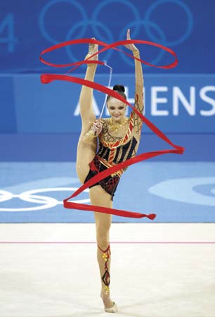
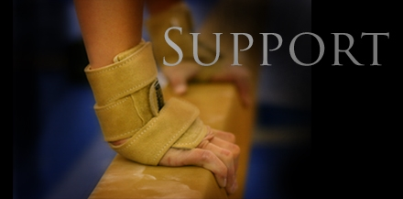
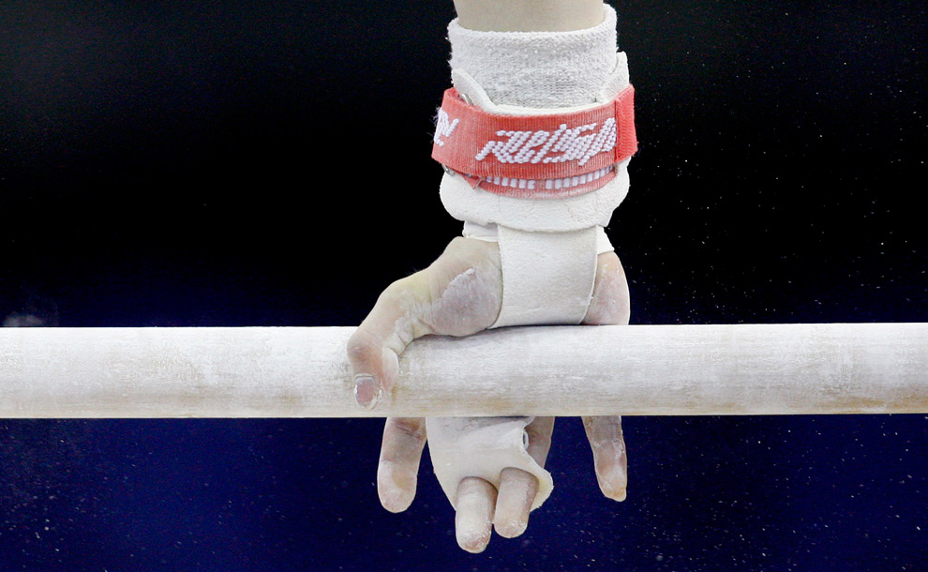
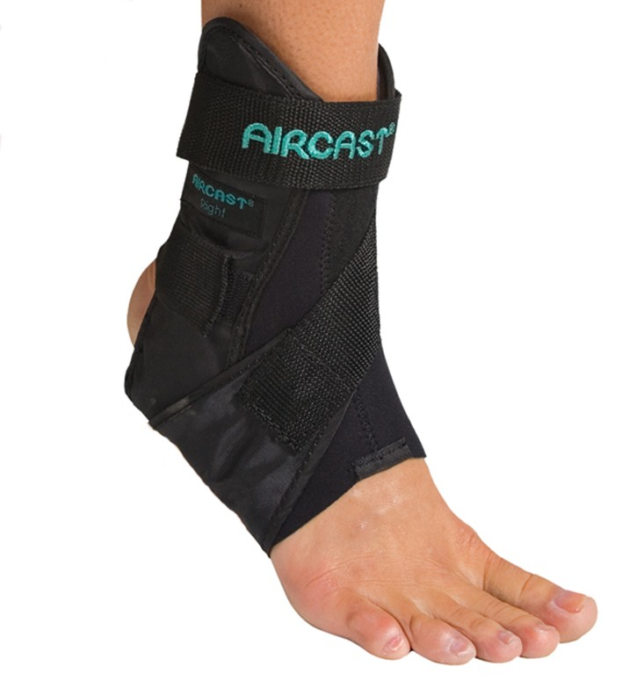
Personal equipment
Grips and wrist bands
Gymnastics shoes
Braces
Wrist guards
Rhythmic gymnastics hand apparatus
Clothing and hair devices

Slide 66
Key Points
Product liability refers to the special legal considerations that are applied to apparatus and equipment. The behavior and use of apparatus and equipment should be monitored and inspected.
Gymnastics apparatus and equipment should be adequate for the skills, ages, sizes and abilities of the gymnasts using the apparatus and/or equipment.
Gymnastics professionals and athletes should use apparatus and equipment that meets the standards established by the relevant governing body for their area of gymnastics.
Gymnastics professionals should adhere to the intended use of gymnastics apparatus and equipment.

Slide 67
Key Points (cont.)
Gymnastics uses a number of different types of apparatus and equipment. Each of these items requires special consideration and specific care and maintenance.
Gymnasts can use their own personal equipment. Coaches, instructors and athletes should work together to ensure the fit, safety and appropriate use of such equipment.
Coaches, instructors, judges and athletes should develop a vigilant habit of checking the settings and condition of all apparatus and equipment routinely prior to use.

Slide 68
Unit 5 Quiz
What is the difference between apparatus and equipment?
There is no difference
Apparatus are those items used directly for competition and equipment includes items used for training purposes
Apparatus are big pieces of equipment
Apparatuses and equipment are the same thing

Slide 69
Unit 5 Quiz
No one should ever be allowed on apparatus or equipment without supervision EXCEPT:
Team athletes
No one means “No One”
Coaches and instructors
High Level gymnasts

Slide 70
Unit 5 Quiz
Which of the following factors should be considered for appropriate selection and use of gymnastics apparatus and equipment?
Gymnastics skills being performed
Age and size of the athletes
All of these factors should be considered
Ability of the gymnasts

Slide 71
Unit 5 Quiz
Gymnasts and coaches should work together to ensure which of the following regarding personal equipment items (e.g. grips, gymnastics shoes, braces, etc.)?
All of the above
Appropriate usage
Safety
Proper fit

Slide 72
Supervision & instruction
“It’s not what you look at that matters, its what you see.” ~ Henry David Thoreau

Slide 73
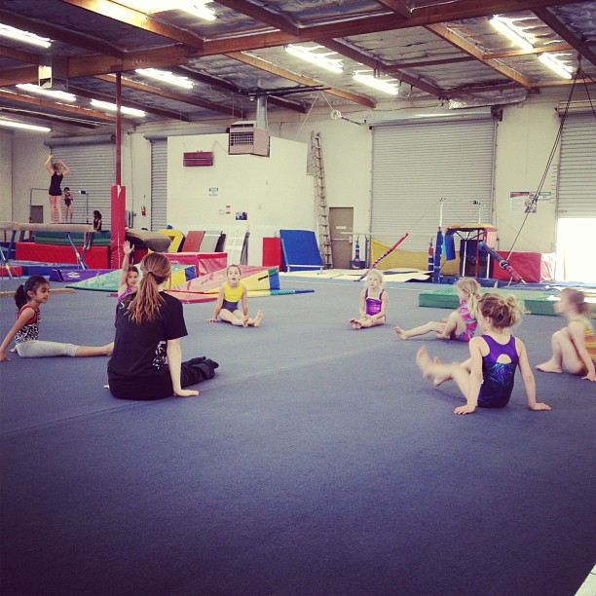
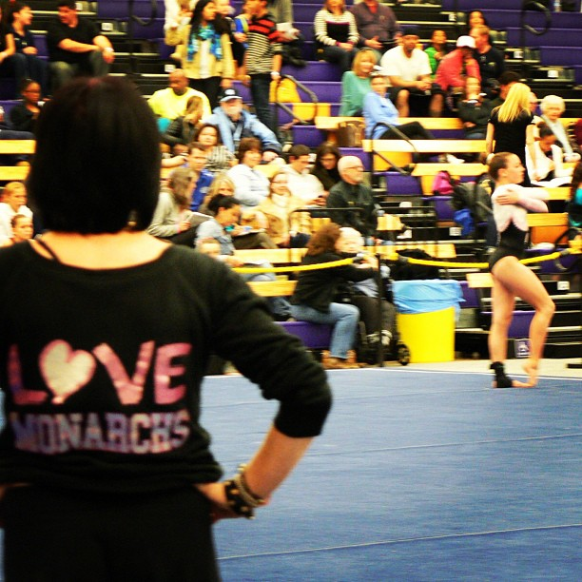
Instruction & Coaching
Instructor
Is an individual who teaches students who participate in gymnastics at a preschool and/or recreational level
Coach
Is an individual who instructs, guides and prepares students for gymnastics competition

Slide 74
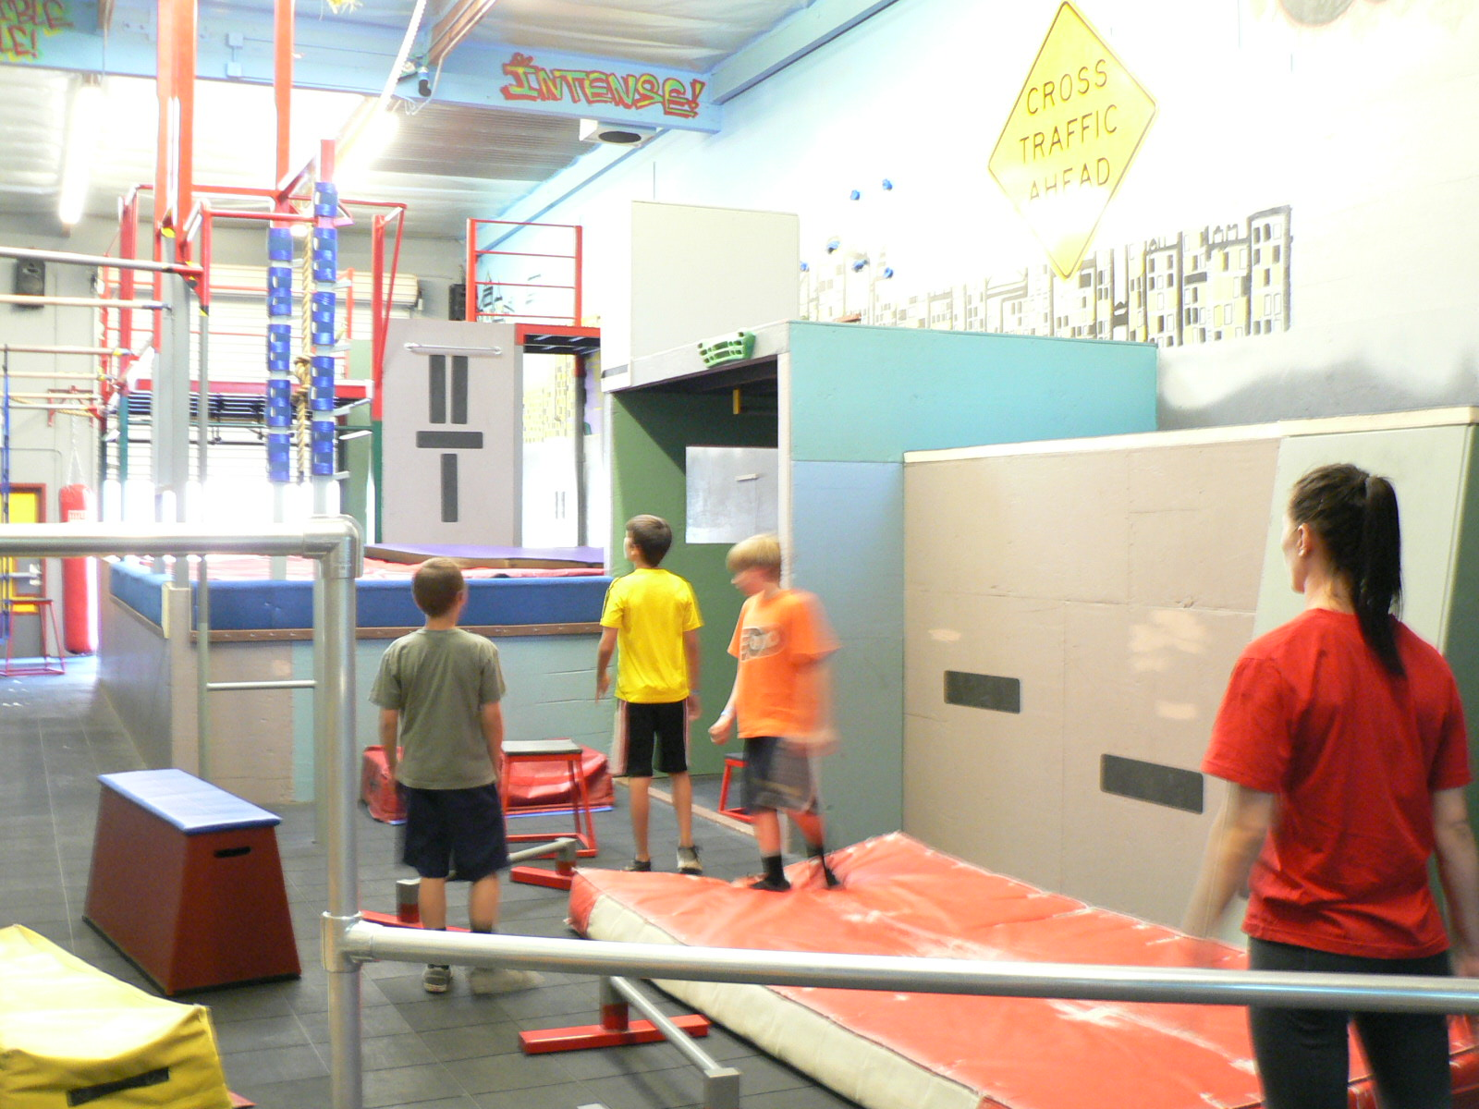
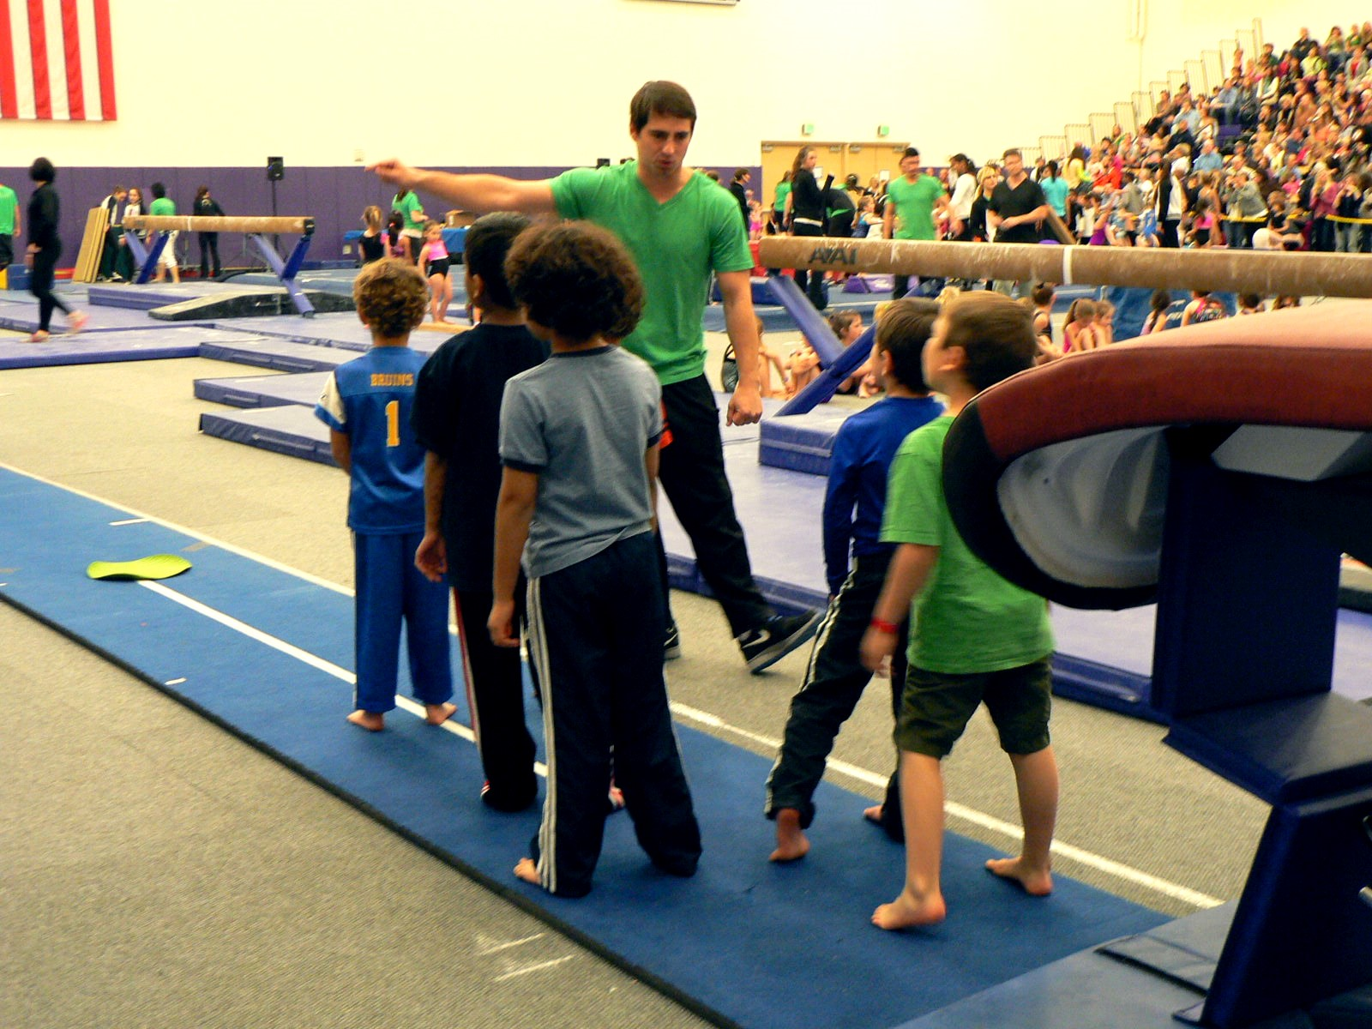
Unsupervised gymnastics should NOT be allowed in the gymnastics setting!
Supervision is defined as overseeing the activities of participants and is designed to help prevent injuries.

Slide 75
Levels of supervision
Direct Supervision Indirect Supervision
more direct control less direct control
Gymnastics professionals should:
Select supervision levels that are appropriate to the risks involved, experience of the athletes, and predictability of the activity
Know where to position themselves
Use both direct and indirect supervision simultaneously when working with more than one gymnast at a time
Learn to regularly look up from direct supervision to perform indirect supervision

Slide 76
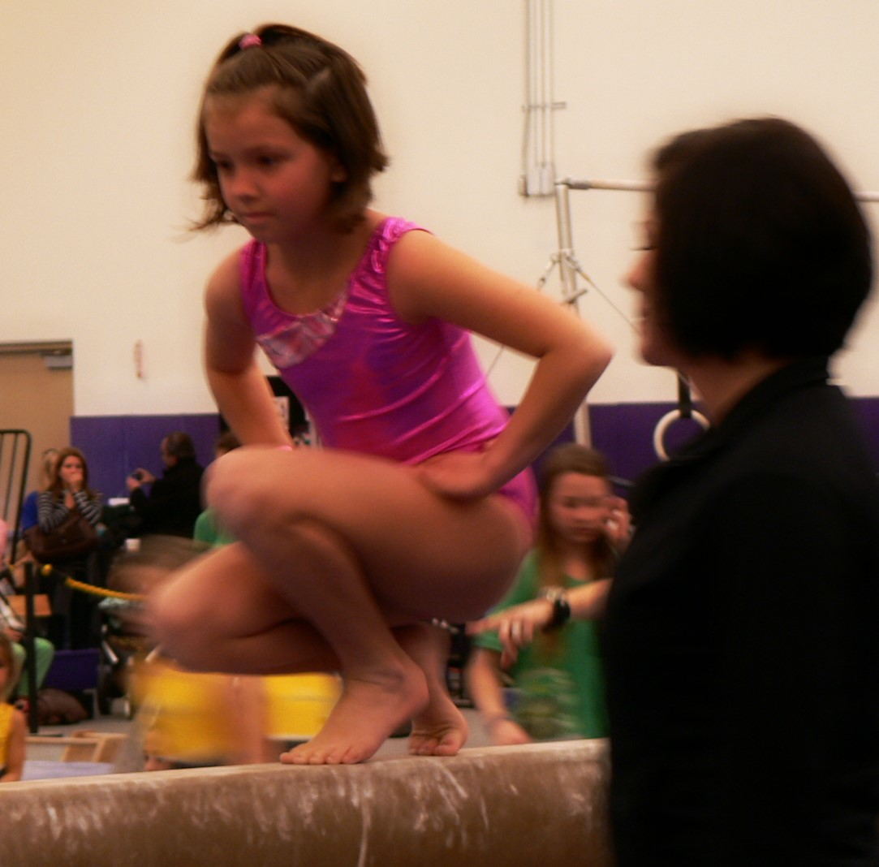
Direct supervision
Direct Supervision
Implies a more engaged, more attentive and more closely involved supervisor and that the instructor or coach is in full command of all activities taking place

Slide 77
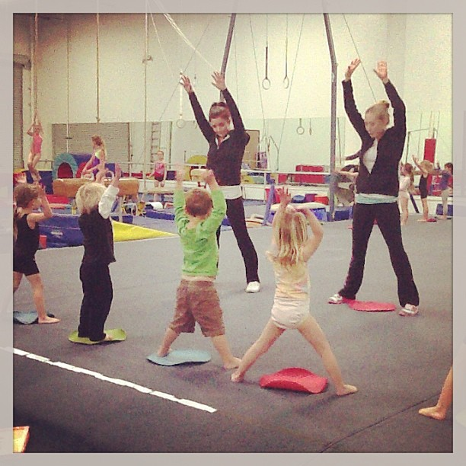
Indirect supervision
Indirect Supervision
Implies that an instructor or coach is present but that he/she is not controlling all activities indirect supervision is appropriate when the athletes have demonstrated performance competency to a point that do not, or should not, have an instructor or coach intruding on the activity.

Slide 78
Proper supervision
Proper supervision should include:
Knowing how to scan
Positioning yourself for effective viewing
Spotting red flags
Being familiar with the activity
Inspecting and removing hazards
Transferring of athletes from one coach/instructor to another
Providing safety education and enforcing rules and policies
Overseeing practice times, as well as, times before and after
Training areas, locker rooms, restrooms, and equipment and ancillary areas

Slide 79
Supervision example
A teacher is instructing eight students on floor with the main objective of performing a backbend. The teacher sets up four stations of activities and positions herself at one of the stations to spot backbends. By spotting, the teacher is providing direct supervision to the student being spotted, meaning the teacher is working one-on-one with the student. However, the teacher is also responsible for overseeing, directing and providing feedback to the seven students at the other three stations. This is indirect supervision.

Slide 80
Supervision tips
Escort athletes as they transfer to another coach/instructor or station. This will help prevent a period of time with no supervision.
Position yourself to see the entire area, without turning around. This also applies to spotting, as you should easily be able to look up and see the other athletes you are responsible for.
Position athletes so they are facing you, with their backs toward other activities in the gym. This approach helps the gymnasts listen to the supervisor and avoid distractions.
Follow written policies and procedures when a coach/instructor must leave an area and transfer supervision to another staff member (e.g., to help with an injury or visit the restroom).

Slide 81
Other considerations
Gender sensitive supervision
Supervision before and after class
Emergency supervision
Safety rules
Matching of athletes and coaches
Athlete: coach/instructor ratio
Gender-sensitive supervision:
Supervision of the opposite sex is a potential problem area. Obviously, restroom and locker room areas require supervision by the appropriate gender. Written plans and policies for supervision of opposite gender athletes should be made, published and followed.

Slide 82
Other considerations
Gender sensitive supervision
Supervision before and after class
Emergency supervision
Safety rules
Matching of athletes and coaches
Athlete: coach/instructor ratio
Supervision before and after class:
Supervision begins when the athlete arrives at the facility and does not end until the athlete leaves the property. Supervision is required as long as athletes are present even when no gymnastics-specific activities are taking place.
A single staff member, coach, or instructor should not be alone with a single athlete – this applies for private lessons, stranded athletes or in other situations.

Slide 83
Other considerations
Gender sensitive supervision
Supervision before and after class
Emergency supervision
Safety rules
Matching of athletes and coaches
Athlete: coach/instructor ratio
Emergency Supervision:
All staff should be aware of emergency procedures, how to handle an injury, how to handle an injury, how to summon aid, and how to handle supervision of the uninjured athletes while the injured athlete is attended to.

Slide 84
Other considerations
Gender sensitive supervision
Supervision before and after class
Emergency supervision
Safety rules
Matching of athletes and coaches
Athlete: coach/instructor ratio
Safety Rules:
Supervision includes educating, through explanation and demonstrations, participants regarding safety rules. For instance, gymnastics curriculum should include landing drills and safety rolls so gymnastics learn how to land and fall properly.

Slide 85
Other considerations
Gender sensitive supervision
Supervision before and after class
Emergency supervision
Safety rules
Matching of athletes and coaches
Athlete: coach/instructor ratio
Matching of athletes and coaches:
Participants should be matched so that athletes responsible for supporting and lifting other athletes, such as with acrobatic gymnastics or group gymnastics are physically able to perform the task. Proper matching of a coach/instructor and an athlete is also important for spotted skills. An additional consideration is proper alignment of coaches/instructors and athletes in terms of skill level.

Slide 86
Other considerations
Gender sensitive supervision
Supervision before and after class
Emergency supervision
Safety rules
Matching of athletes and coaches
Athlete: coach/instructor ratio
Athlete: coach/instructor ratio:
The number of athletes under the care and direction of an instructor or coach should be consistent with the:
Level of ability and experience of the instructor / coach
Skill level of the athletes
Age and gender of the athletes
Type of tasks being practiced
Available space, type of equipment and other distractions in the facility.

Slide 87
instruction
Instruction
Providing athletes the information necessary to safely participate
Instruction Involves:
Skill teaching
Spotting
Feedback
Information about equipment
Education and enforcement of safety rules
Raining in the areas of fitness and gymnastics preparation

Slide 88
Stages Of Teaching
1
Initial Discomfort
~ Lack of a large repertoire of skills and knowledge
~ Fall back to the way they were taught
2
Learning Techniques
~ rapid increase in the number and breadth of teaching skills
~ Still unable to handle multiple simultaneous activities
3
Multi-Tasking
~ aware of several things at the same time
~ shows signs of “intuitive” ability to regulate learning activities & maintain order
4
Seeing More Clearly
~adept at providing feedback that is more directed and relevant
~ identifies a subtle perform-ance problem
5
Confidence & Anticipation
~ operates intuitively at many levels
~ relies on pattern matching versus rules

Slide 89
Stages of teaching
Gymnastics coaches and instructors should have responsibilities for skills, gymnasts and tasks in accordance with their level of teaching ability. Developing an expert level of teaching ability requires considerable experience, practice and study.

Slide 90
Class / practice management
Class management
Refers to the procedures and routines that are used to keep the gym running smoothly
Prepared Organized Consistent
Appropriate class/practice management can help reduce behavior problems and injuries because athletes are busy and on-task. It also increases the FUN and enjoyment of gymnastics!

Slide 91
Management guidelines
Take Ownership & Be Responsible
~ Be in charge at all times and take responsibility for the outcome
~ Be proactive and keep the athletes moving and active as much as possible
~ know each athlete’s name
Prepare A Safe Class Environment
~ set up apparatus/equipment before the start of class/practice
~ Control entry activities
~ start class promptly
~ avoid interruptions and breaks
Have A Lesson Plan
~ begin with a warm-up
~communicate high, yet reasonable expectations
~ provide positive feedback
Establish Protocols
~ gain the athletes’ attention
~ use specific and consistent signals
~ teach “home base”
~ identify boundaries
~ develop gym rules
~ walk the walk

Slide 92
Tasks of teaching
Identifying and correcting technique errors
Utilizing skill progressions
Correct techniques
Take all reasonable steps to ensure that athletes learn appropriate techniques and skills
Know the difference between serious and harmless mistakes
Implement skill teaching in a progressive format
Progressions allow the gymnast to proceed in an orderly fashion from novice to a more advanced level in “bite-size” steps

Slide 93
Tasks of teaching
Providing demonstrations
Spotting
Correct performance
Give several times
Include common errors and how to avoid them
By the coach/instructor or another athlete, video presentations, computer simulations, etc.
Manipulate, support or catch a gymnast during a skill
Be in a position to provide support

Slide 94
Tasks of teaching
Providing feedback
Provide direction for activities
Help athletes make improvements in performance
Command athletes for performing or behaving well
Promptly address unsafe behaviors
Focus on the most critical errors

Slide 95
Tasks Of Teaching
Positive feedback is an effective way to motivate athletes and encourage them to continue positive behaviors. Try re-wording your feedback to make it more positive.
Instead of: “Don’t kick your leg so high before going into the handstand.”
Say: “Kick your leg to horizontal before going into handstand.”

Slide 96
Special instructions
Growing up
Growth:
Changes in size (height & Weight)
Maturation:
Changes in maturity, usually measured by secondary sex characteristics
Development:
Psycho-social changes

Slide 97
Special instruction issues
Rapid periods of growth have been implicated in an increase incidence of injury.
Training intensity may need to be reduced during rapid growth.
Additionally as growth proceeds, gymnasts encounter new learning and performance challenges.

Slide 98
Special instruction issues
Areas of importance:
Children grow at different rates and by different amounts.
Growth tends to occur in spurts – children grow rapidly in infancy and early childhood, slowly during middle childhood, rapidly during adolescence, and finally slowly as they reach their adult height.
Growth plates are areas near the ends of long bones where cartilage has not yet ossified into bone. Growing children tend to have bones with areas more vulnerable to fracture – growth plates, which are weaker than fully ossified bones.
Physiological changes include strength, muscular endurance, cardio-respiratory endurance and flexibility occur in addition to changes in size and maturity.
Gymnastics professionals should appreciate increasing strength fitness is one of the most important means available to prevent injury.

Slide 99
Areas of importance
Gymnastics performance relies on the athletes ability to perceive surroundings and interpret sensory information. Children develop their perception and information processing capabilities as they grow and mature. Gymnastics can serve as an ideal environment to explore spatial orientation.
Spatial orientation is important to gymnastics. Giving instructions often relied on describing body orientations in space. Young gymnasts must be able to correctly interpret instructions and translate them into personal movement. The gymnastics professional should tailor his/her instructions, drills and demonstrations to match the perceptual and information processing capabilities of the gymnast.

Slide 100
Key Points
Supervision is essential in all aspects of gymnasts. All athletes should be supervised at all times.
Supervision ranges from direct supervision to indirect supervision. Direct supervision implies a more strict and coach/instructor – driven teaching-learning situation. Indirect supervision can be used for activities of lower risk where supervisors engaged presence can maintain safety. Coaches and instructors must adjust their level of supervision along the continuum many times during a practice or a class, based on the needs of the situation
Gymnastics professionals should be aware of special circumstances of supervision, such as opposite gender supervision and policies for handling a stranded gymnast.

Slide 101
Key Points (cont.)
Athletes and coaches should be matched appropriately to tasks being taught and spotting tasks required.
Instruction must be undertaken by qualified gymnastics professionals.
Information conveyed during instruction should be correct and appropriate to the age and skill of the athlete.
Gymnastics professionals should understand the stages and styles of teaching. Inexperienced and unskilled teachers should not be placed in situations beyond their experience and expertise. Different teaching styles should be matched with different learning and training situations.

Slide 102
Key Points (cont.)
Safety can be enhanced by knowing and employed specific teaching methods and procedures that are matched to the needs of the situation.
Spotting is an important skill for most gymnastics coaches and instructors. Spotting is not required for the safe teaching of skills; however, if spotting is not included, clever progressions and other methods must be used to maintain safety.
Children are not mature adults. Growing up is a complex process that is replete with size, physiological, perceptual and motor changes that occur as the child grows and matures.

Slide 103
Unit 6 Quiz
Which of the following statements is a result of appropriate class/practice management.
Help reduce behavior problems
Help reduce inures
Increase the fun of gymnastics
All of these are results of good management
Proper supervision involves which of the following?
Being familiar with the activity
Overseeing only practice times
Looking in only one direction
Allowing athletes to move around the gym by themselves.

Slide 104
Unit 6 Quiz
Which of he following is NOT a task of teaching?
Utilizing skill progressions
Providing feedback
Telling stories to the athletes
Correcting technique errors
The number of athletes under the care and direction of an instructor or coach should be consistent with which of the following?
All of the listed factors should be considered
Level of ability and experience of the instructor or coach
Skill level of the athletes
Age and gender of the athletes

Slide 105
Unit 6 Quiz
There are times when unsupervised gymnastics is allowed in the gymnastics setting.?
TRUE
FALSE

Slide 106
Preventing Child Abuse in Gymnastics
“An ounce of prevention is worth a pound of cure.” ~ Benjamin Franklin

Slide 107
ZERO TOLERANCE
ABUSE IS WRONG & SHOULD NOT BE TOLERATED
Monarchs has adopted the USA Gymnastics Participant Welfare Policy that affirms its commitment to the welfare of gymnastics participants in its organization that includes:
Description of conduct that will not be tolerated
Standards of behavior for staff/volunteers that promote participants welfare.
Process for receiving and handling complaints regarding conduct that violates the policy.

Slide 108
Coach-Athlete Relationship
A successful coach-athlete relationship is built on trust and power.
Trust
Is the confidence placed in someone
Power
Is the ability to give or take away something of value

Slide 109
Physical & sexual abuse
Sexual misconduct and abuse are often difficult to comprehend and little discussed, which may lead to misconceptions and biases. And abuse and misconduct have devastating effects on the athletes involved, as well as the entire program.
Don’t rely on what “you think you know” about this problem. Find out the facts and get educated regarding prevention and intervention measures.
Participants Welfare Policy | Child Welfare Organizations
Clubs Care Campaign
Coaches should NOT introduce sexually based interactions into the coach-athlete relationship.

Slide 110
Prevention
AWARENESS + ACTION = PREVENTION
Categories of prevention efforts:
Understanding, watching for an interrupting predatory tactics
Eliminating or minimizing opportunities for abuse
Interrupting Predatory Tactics:
Predators are often adept at deception. Like many successful professionals, offenders can be highly qualified, intelligent, patient and have good interpersonal skills and a positive self-image.

Slide 111
Grooming
Is a term used to describe the prolonged and purposeful tactics of a predator to target and gain the trust/compliance of the victim and avoid detection.
Behaviors to look for:
Is this person befriending a youngster and their family to slowly gain trust?
Does this person give gifts or money to an athlete for no reason?
Is this person promoting the relationship with the athlete as special?
Does this person try to separate the athlete from teammates/parents or find ways to be alone with the athlete?
Does the person often have a “special” relationship with one child?

Slide 112
Grooming Process
Stage 1:
Targeting a victim
Stage 2:
Gaining Trust
Stage 3:
Recognizing and fulfilling needs
Stage 4:
Isolating the child
Stage 5:
Sexualizing the relationship
Stage 6:
Maintaining control

Slide 113
Minimize opportunities
One-on-one Situations
Do not permit one-on-one sessions between coach and gymnast
Conduct private lessons where others can observe
A minimum of two staff members should remain until all gymnasts are picked up.
Do not contact athletes for any reason except club business

Slide 114
Minimize opportunities
Overnight Travel
Conduct bed checks in pairs
Encourage contact between athletes and parents by phone or video chats
Assign athletes to a hotel room with the same-age and same-sex teammate
An athlete and a coach should not share a room or be alone together in a room.

Slide 115
Minimize opportunities
Local Travel
DO NOT ride in cars with athletes
Have parents transport their own child
Develop strategies to eliminate a sole driver and use two, unrelated adults instead
Set-up carpools with many adults sharing responsibilities
Transport athletes in groups from a designated location to eliminate one-on-one situations
Receive notarized note from parent

Slide 116
Minimize opportunities
Social events, especially those involving alcohol
Provide appropriate monitoring of social events
Limit or eliminate alcohol from social outings
An athlete group with a wide range of ages and developmental stages
Monitor groups of athletes
Divide athletes into age-appropriate and development appropriate groups when possible.

Slide 117
Intervention: Signs To look For
Be Aware of:
Sudden behavioral changes in the athlete
Loss of enthusiasm for their sport
Lack of desire to practice or put in extra work like they used to
Self-defeating Behavior
Discounting their effort so their performance will decline and they will not be selected for team
Other behavioral or emotional changes
Depression
Anxiety
Becoming reserved and withdrawn
Interacting with people differently

Slide 118
Intervention: How To Intervene
Have a conversation with the athlete
Tell the athlete what has been observed
Unexplained outburst, decline in performance
Ask if anything is wrong, specifically if something is going on around them
Offer to help the athlete with whatever the issue is
If the athlete says nothing is wrong
Continue to monitor behavior and raise the concerns again, if necessary
If the athlete reports abuse
Listen carefully and calmly
Let the athlete know abuse is wrong, sexual advances can be refused, and he-she is not at fault
Consult counsel about reporting obligations

Slide 119
Intervention: How to Respond
Step 1:
Interrupt or disrupt the conduct
If the gymnastics professional sees abuse occurring, do what is reasonably necessary given the circumstances to stop the abuse.
Step 2
Report to the designated administrator
Be familiar with your clubs policies so you know how and to whom to report
Step 3
Consult legal counsel
Reporting requirements vary by state, so consult with counsel about your duty to report to the proper law enforcement authorities

Slide 120
Key Points
Zero Tolerance: no gymnastics professional or club should tolerate physical or sexual abuse
Have a policy that affirms the club’s commitment to the welfare of gymnastics participants and includes, at minimum, a description of conduct that will not be tolerated; standards of behavior for staff/volunteers that promotes participant welfare, and a process for receiving and handling complaints regarding conduct that violates policy.
A successful coach-athlete relationship involves trust and power. Coaches must take care not to abuse that trust and power.

Slide 121
Key Points (Cont.)
Interrupting “grooming” (the prolonged and purposeful tactics of a predator to target and gain the trust/compliance of the minor and avoid detection) and eliminating or minimizing high-risk opportunities are keys to preventing sexual abuse and misconduct.
Work to eliminate private situations (both physical and electronic) that many make abuse possible.
Many states mandate a report of any suspected abuse. However, reporting requirements differ from state to state, so check with legal counsel regarding reporting obligations.

Slide 122
Unit 7 Quiz
Which of the following best describes zero tolerance?
No gymnastics professional or gymnastics club should tolerate physical or sexual abuse.
Abuse is tolerated in certain situations.
The club owner suspecting the sexual abuse should observe the professional for one month to see if his/her actions continue.
Don’t ask, don’t tell.

Slide 123
Unit 7 Quiz
Which USA Gymnastics’ policy identifies behaviors considered physical and sexual abuse and affirms the organizations commitment to the welfare of gymnastics participants?
Bylaws
Participant welfare policy
Code of ethical conduct
Rules and policies

Slide 124
Unit 7 Quiz
Preventing abuse involves which of the following tactics?
Interrupting predator tactics
Eliminating opportunities for abuse
All of these tactics can help prevent abuse
Understanding relationships and predatory behaviors

Slide 125
Unit 7 Quiz
“Grooming” is the prolonged and purposeful tactics of a predator to target and gain the trust/compliance of the victim and avoid detection. Which of the following statements is NOT true about the grooming process?
Predators maintain control of a victim through attention, affection, and gifts
Predators develop a special relationship with their victim, fulfilling the victims needs
Grooming usually occurs within a day or two
Predators often find opportunities to isolate the victim.

Slide 126
Unit 7 Quiz
Which of the following is NOT a step that should be taken if abuse is suspected?
Consult legal counsel regarding reporting to law enforcement
Report to a club administrator
Interrupt the misconduct
Do nothing, since you are unsure

Slide 127
Miscellaneous Risk Management Issues

Slide 128
Miscellaneous Risk Management Issues
“What may look simple to someone accustomed to a contact may be hard to someone new to that context.” ~ Edward Redish

Slide 129
Ethics
Is a term that is used to describe the moral behavior of an individual that often affects the organization.
Do the Right thing at the RIGHT time!
Fairness
Characters
Accountability
Interaction with Others
Guides Conduct
Respect
Business Dealings

Slide 130
safety team – Officials Are responsible for:
Enforcing the rules of gymnastics:
Example: limiting unsportsmanlike conduct when coaches, athletes, partisan spectators or other interfere with te safe conduct of a competition.
Helping ensure a safe experience:
Example: intervene to help avoid a safety issue and/or impending injury.
Determining the safe placement, setup, and configuration of apparatus:
Example: ensure that apparatus configuration meet the specifications of the governing body overseeing the competition.

Slide 131
Officials: in Depth
During a run-up to the vault, a spectator drops something that rolls onto the vault runway. An official should not hesitate to stop the gymnasts approach to remove the debris.
If mats have become separated and increases the danger of stepping into a crack, the official should use his/her best judgment regarding when to intervene and then ensure that the mats are placed properly.

Slide 132
Other activities in the gym
Alternate activities that can take place in a gymnastics setting include:
Cheerleading
Gymnastics for athletes with needs
Preschool gymnastics
Dance classes
Birthday parties
Field trip outings
And more!

Slide 133
Key Points
Ethics is the moral behavior of an individual that often affects the organization and plays an important role in safety.
Officials are part of the safety team. When officials detect an unsafe situation, they should use good judgment and intervene when and where appropriate.

Slide 134
Unit 8 Quiz
Which of the following are members of the safety team?
Coaches
Judges
All of the individuals are members of the safety team.
Meet directors
Which of the following is an example of ethical behavior?
Cheating
Gossiping
Doing the right thing at the right time
Skipping work

Slide 135
Unit 8 Quiz
Ethical practices are a risk control technique?
TRUE
FALSE
Which of the following best defines “ethics”?
Moral behavior that often affects the organization
Doing whatever is easiest
Befriending all participants
None of these define ethics

Slide 136
Unit 8 Quiz
Which of the following is a responsibility of an official at a competition?
Work to ensure a safe experience
Enforcement of the rules of gymnastics
Asses the safe placement, set-up, and configuration of apparatus
Officials are responsible for all of these duties.

Slide 137
Preparation for gymnastics
“I will prepare and some day my chance will come.” ~ Abraham Lincoln

Slide 138
Injury Prevention
Preparation is:
Psychological
Tactical
Technical
Physical
Philosophical
Develop a mindset that will enhance and inspire good judgment and vigilance in preventing injury.

Slide 139
Philosophical Preparation
Philosophically, safe awareness is paramount to preventing injury and ensuring a valuable experience for everyone involved in gymnastics. A safety mindset should be incorporated into all program policies and decisions. The gymnast should also be encouraged to develop these same philosophical views.
Good Judgment Thinking Ahead
Common Sense Safety Mindset

Slide 140
Physical Preparation
Areas of physical preparation include:
Participant readiness
Warm-up
Gymnastics Fitness
Nutrition
Physical fitness is perhaps the single most practical means of injury prevention

Slide 141
PPE: In Depth
A PPE should be required if an athlete has any of the following symptoms or characteristics:
Atlantoaxial instability
Acute illness
Cardiovascular disease
Congenital heart disease
Detached retina or loss of one eye
Absence of a kidney
Enlarged liver
Musculoskeletal disorders
History of concussion
History of serious head or spine injury
Convulsive disorder
Respiratory insufficiency
Asthma, exercise-induced bronchi spasm
Skim disorders: boils, herpes, impetigo, scabies
Enlarged spleen

Slide 142
Physical: Warm-up
Warm-up activities should be:
Included prior to gymnastics training
Tailored to meet the demands of the subsequent exercises
Warm-up Tips:
General warm-up: first should include activities that increase the body temperature (e.g. running, aerobic activities, rope skipping, dance), then stretching or moving each body part through increasingly greater ranges of motion.
Specific warm-up: should involve skill or movement rehearsals.

Slide 143
Physical: Gymnastics Fitness
Cardio Respiratory Endurance
Muscular endurance
Muscular strength
Flexibility
Body Composition
Cardio-respiratory endurance:
Ability to do moderately strenuous activity over a period of time.
Reflects how well the heart and lungs work together to supply oxygen to the body during exertion.

Slide 144
Physical: Gymnastics Fitness
Cardio Respiratory Endurance
Muscular endurance
Muscular strength
Flexibility
Body Composition
Muscular endurance:
Ability to do moderately ability to hold a particular position for a sustained period of time, or
Ability to repeat a movement many times.

Slide 145
Physical: Gymnastics Fitness
Cardio Respiratory Endurance
Muscular endurance
Muscular strength
Flexibility
Body Composition
Muscular strength:
Ability to exert maximum force, such as lifting the heaviest weight possible, one time
Possible to have muscular strength in one area (i.e., arms) while lacking in another area (i.e. legs)

Slide 146
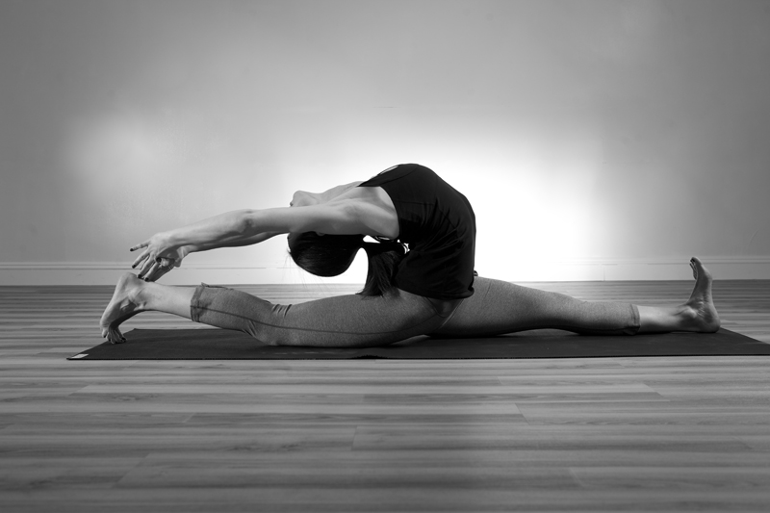
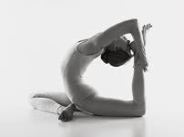
Physical: Gymnastics Fitness
Cardio Respiratory Endurance
Muscular endurance
Muscular strength
Flexibility
Body Composition
Flexibility:
Ability to move a joint through its full range of motion
Elasticity of the muscle

Slide 147
Physical: Gymnastics Fitness
Cardio Respiratory Endurance
Muscular endurance
Muscular strength
Flexibility
Body Composition
Body Composition:
Proportion of fat in the body compared to bone and muscle
Does not refer to an individuals weight in pounds or figure

Slide 148
Gymnastics Fitness: In Depth
Fitness areas related to injury:
Excessive flexibility
Inadequate flexibility
Insufficient strength
Fatigue – lack of muscular endurance and strength
Poor posture is also a risk factor for gymnastics injury. Poor posture can result from muscular weakness, deformity, fatigue, incorrect training and laziness.

Slide 149
Physical: Nutrition
The type, amount, composition and timing of food intake can affect performance, recovery from exercise, body weight and composition, as well as overall health.
Nutrients+ Hydration = Nutritional Fitness

Slide 150
Nutrition: Female Athlete Triad
Female Athlete Triad (FAT) consists of:
Disordered eating:
Resulting in low energy availability
Amenorrhea:
Irregular or absent menstrual cycle
Osteoporosis:
Thinning and reduced bone density
Young females are susceptible to FAT. Men can also be at risk for disordered eating. Athletes should be assessed for these conditions at the pre-participation physical exam or annual health screening.

Slide 151
Nutrition: Eating Disorders
Anorexia Nervosa
Bulimia
Is a condition where the gymnast becomes obsessed with body weight and food avoidance. Anorexics may employ secrecy, starvation, forced vomiting, laxatives, diuretics, diet pills, and/or compulsive exercise.
Refers to a constellation of symptoms, such as abnormal craving of food, secrecy, dramatic episodes of overeating, self-induced vomiting, lack of control with over-eating, and/or extreme concern about body size and shape
Gymnastics professionals should NOT recommend unhealthy weight control practices!

Slide 152
Technical Preparation
Technique Tips:
Techniques can be taught using pictures, demonstrations, videos, drawings, verbal descriptions / directions, and/or lead-up progressions
Technique is solidified through repetitive performances
Proper techniques should develop into habit through continued practice.
Fatigue is a risk factor for technical errors, which cause a deterioration in performance, altered load characteristics on the body, and the potential for injury.

Slide 153
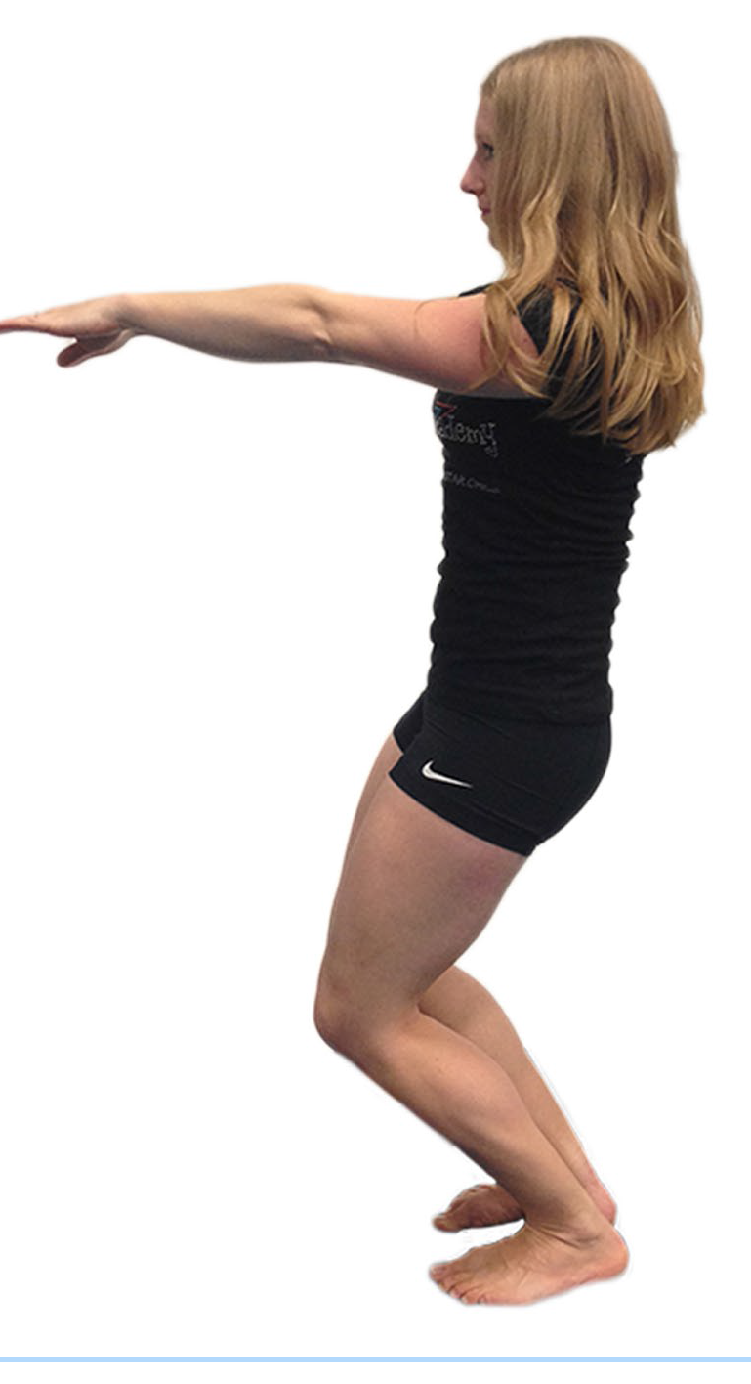
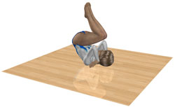
Technical: Landing & Falling
Landings
Learning to Fall:
Proper landing technique helps to dissipate the forces of landing impacts. A safe landing position should become a habit or natural position for all gymnasts.
One of the major benefits of gymnastics instruction for gymnasts and non-gymnasts is learning to fall and avoiding injury by falling skillfully. The primary skill for gymnastics falls is rolling. Gymnasts should practice falling and rolling to help them absorb the impact of a fall over a greater area of their body.

Slide 154
Tactical Preparation
Tactics refers to strategies
Tactics can involve:
Rules
Skill selection
Skill sequencing
Music selection
Skill progression (lead-up) selection
Routine construction and choreography
Age-appropriate skill learning
Competitive approaches

Slide 155
Tactical Preparation Tips #1
Lesson Plans
Take into account the age, ability, and individual differences of athletes: provide variations in the skills to match the level of the athletes.
Learning Interference:
Be mindful of the sequencing of skill learning to avoid conflicts in learning and performance that arise from skills that have similar movements in the beginning and different movements at the end. These conflicts can result in learning problems and increase the potential for injury.

Slide 156
Tactical Preparation Tips #2
Routine Composition:
Reflect the gymnasts ability to handle longer sequences of difficult skills, maximize potential score while minimizing potential for injury.
Skills that require sensitive spatial orientation:
(e.g., forward somersaults and dive rolls from somersaults) increase vigilance and attention to detail because the landing phase is less visual, which places greater emphasis on the spatial awareness of the gymnast. These skills are more prone to error than skills that allow the athlete a clear and relatively early view of the landing surface.

Slide 157
Tactical Preparation Tips #3
Landing surfaces and training areas:
Adjust for the experience of the athlete, difficulty of the skill, and potential for overuse-type injuries. Tactical selection of an appropriate learning environment can prevent many injuries that result from unplanned falls or collisions.

Slide 158
Psychological Preparation
Self-concept:
Research has shown that athletes with low self-concepts may be willing to take more risks and are thus injured more often than athletes with higher self-concepts. Sport psychologists have speculated that athletes with low self-concepts may use injury as something to blame in order to avoid failure.
Reaction to stress:
Stress is defined as a stimulus that causes a reaction. Athletes with fewer coping skills (inability to control arousal, concentrate and think clearly under stress) have been shown to be more injury-prone.

Slide 159
Psychological Preparation
Coping skills:
The ability to cope with stress (i.e., deal with stress more efficiently and effectively) involves emotional adjustments and social networks. Studies have shown that coping skills are important to injury prevention.
Personality:
Personality may indirectly lead to injury through exaggerated emotional responses.
Support Network:
The athlete’s social support network includes coaches, instructions teammates, family, friends, etc. social support appears to be very important in both alleviating the impact of daily hassles and helping an athlete return from injury.

Slide 160
Key Points
Gymnastics professionals should know the limitations and skills of their athletes and properly match them to the skill level in the sport.
When done properly, gymnastics training is a potent means of preventing injury.
Philosophical preparation is perhaps the most important part of gymnastics preparation. A safety mindset and a philosophical orientation toward safety is a fundamental step in enhancing the safety of gymnastics preparation.
Physical fitness is perhaps the single most practical means of injury prevention. Physical preparation forms the foundation of all the other preparation components.

Slide 161
Key Points (cont.)
Athletes should document their readiness for participation in gymnastics via a pre-participation physical exam, a self-administrated heath history survey, or health waiver on a registration form.
Athletes should undergo a warm-up prior to activity.
Nutritional fitness involves acquiring all of the various nutrients needed by the athletes every day and maintaining proper hydration. Dietary approaches that involve excessive restrictions of nutrients are inappropriate.

Slide 162
Key Points (cont.)
The Female Athlete Triad is a constellation of three disorders: disordered eating, amenorrhea, and osteoporosis. While gymnastics does not cause the FAT and its symptoms because gymnastics is an area where it may develop. The gymnastics professional should seek competent medical help when confronting a suspected FAT problem.
Techniques are integral to gymnastics performance. Gymnastics professionals should be schooled in all the relevant techniques involved in his/her area of coaching or instruction.

Slide 163
Key Points (cont.)
Landing and posture are particularly important areas for observation and care when instructing and preventing injury.
Learning to fall correctly and skillfully is an essential aspect of gymnastics education. All gymnasts should learn to fall safely.
Gymnastics professionals should be aware that the tactical selection of skills and routine composition may be related to injury exposure.
Some gymnastics skills may require more vigilance than others due to differences in difficult and risk.

Slide 164
Key Points (cont.)
Careful selections of landing surfaces is important to ensure that repeated impacts do not result in overuse-type injuries.
Psychological aspects of the gymnast may interact with injury. Gymnastics professionals should seek to enhance the self-concept of the gymnast. Individual reactions to stress and coping skills will vary. The gymnastics professional should be ware of these factors and seek to enhance the personal coping skills and social support network of the gymnast.

Slide 165
Unit 9 Quiz
Which of the following is NOT a component of physical fitness?
Skill progressions
Muscular strength
Flexibility
Cardio-respiratory endurance
Which preparation area is considered the “engineering” of gymnastics?
Technical
Psychological
Physical
Tactical

Slide 166
Unit 9 Quiz
Which of the following areas of gymnastics preparation can help in injury prevention?
Technical
Philosophical
Physical
All of these areas can help with injury prevention
Physical preparation begins with what?
A conditioning program
Flexibility training
A healthy athlete
Discipline

Slide 167
Unit 9 Quiz
The term “tactics” refers to which of the following?
Warm-up
Physical fitness
Readiness for participation
Strategy

Slide 168
Sports Medicine
“the art of medicine consists in amusing the patient while nature cures the disease.” ~ Voltaire

Slide 169
What is sports medicine?
Sports medicine involves:
Injury prevention is the result of:
Prevention
Diagnosis
Treatment
rehabilitation
Education
Identification of risk behaviors
Correct diagnosis
Proper treatment and rehabilitation
Risk management is incomplete without a sports medicine team or sports medicine awareness:

Slide 170
Sports Medicine Team
Team Physicians
Athletic Trainers
Physical Therapists
Instructors and Coaches
Provide oversight for the entire program of the athletes
Performing pre-participation physicals
Make decisions regarding return to activity
Provide treatment to injured athletes

Slide 171
Sports Medicine Team
Team Physicians
Athletic Trainers
Physical Therapists
Instructors and Coaches
Trained in the diagnosis, treatment and rehabilitation of injuries
Perform first-aid
Apply taping and bracing
Make decisions regarding return to activity, usually in consultation with the team physician

Slide 172
Sports Medicine Team
Team Physicians
Athletic Trainers
Physical Therapists
Instructors and Coaches
Provide pain relief and restore function for musculoskeletal and neurological conditions
Enabling and athlete to return as quickly and safely as possible

Slide 173
Sports Medicine Team
Team Physicians
Athletic Trainers
Physical Therapists
Instructors and Coaches
Are often in daily contact with athletes
Are a first line of defense when an injury occurs

Slide 174
Injury Care
PREVENTION
RECOGNITION + TREATMENT
REHABILITATION
Injury prevention:
“The best way to treat an injury is to avoid one.”
~Michael A. Taylor, Author
Best Practices of First Aid in Gymnastics

Slide 175
Injury recognition & Treatment
Emergency Medical Situation
Recognize that an emergency exists
Decide to act
Call the local emergency number (9-1-1)
Provide care until help arrives
Non-Emergency Medical Situation
Provide basic first aid
If pain persists, have the injury evaluated by a medical professional
CPR and first aid certification are important for all gymnastics professionals.

Slide 176
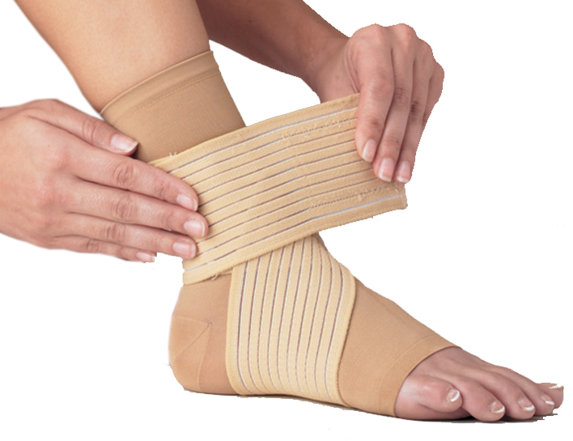
Injury Rehabilitation
Injury rehabilitation should occur under the direction and supervision of a trained sports medicine professional.
Instructors and coaches can provide injury rehabilitation care to an athlete but should follow the instructions of the physician exactly.
All return to activity decisions should be made by the relevant injury care professional.

Slide 177
Emergency Situations
Injuries requiring emergency care include:
Head, neck, or spine injuries
Broken bones and dislocations
unconsciousness
Severe brain injuries
Severe bleeding
Internal bleeding
Cardiac arrest
Lack of breathing
Immediately and efficiently turn-over the care of the athlete to emergency personnel.

Slide 178
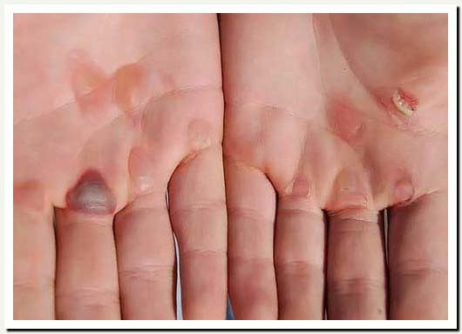
Non-Catastrophic Injuries
Non-catastrophic injuries are those that are not life-or-limb threatening. Non-catastrophic injuries include bruises, blisters, small cuts, strains, and sprains
They Include:
Bruises
Blisters
Small Cuts
Strains
Sprains

Slide 179
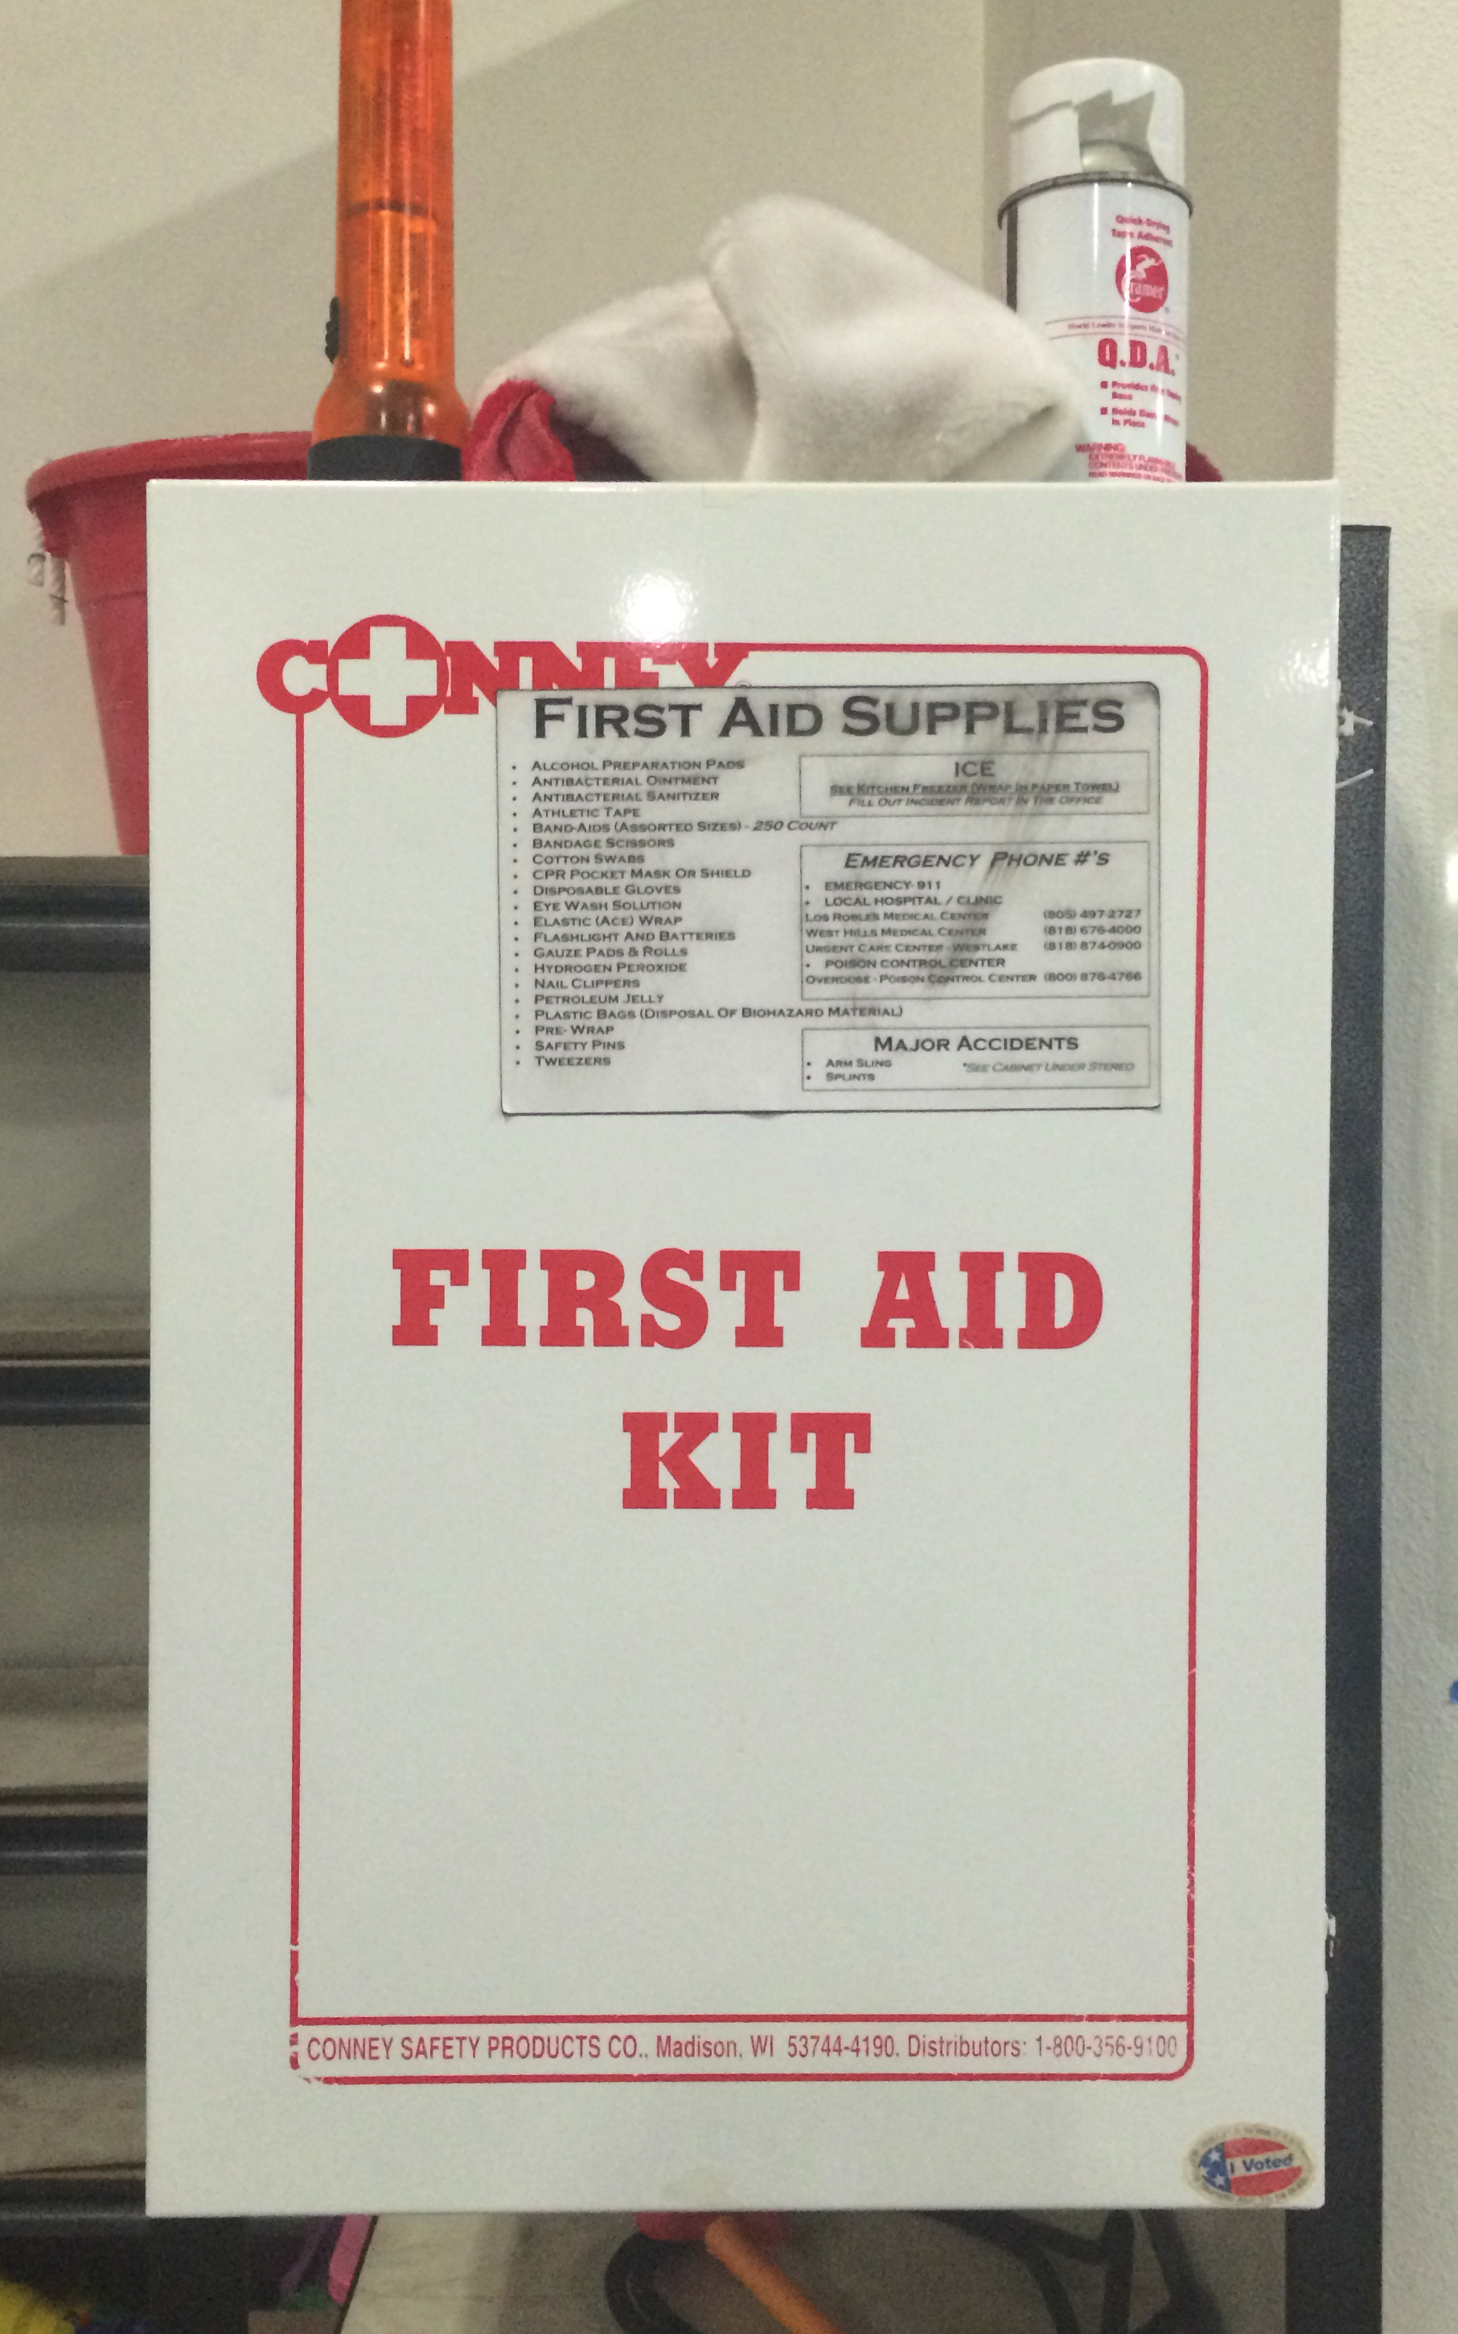
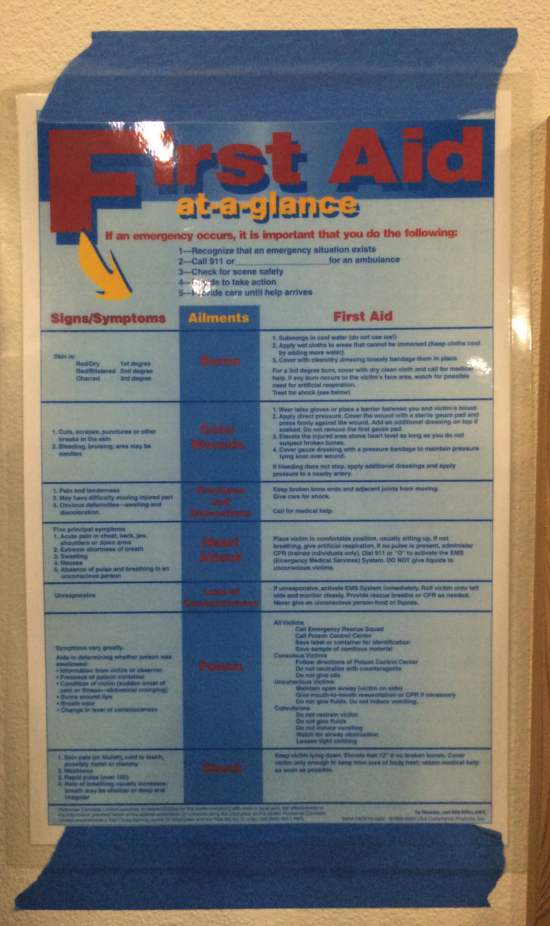
Non-Catastrophic: First-Aid Kit

Slide 180
Non-Catastrophic: R.I.C.e
R.I.C.E
Basic First Aid procedure used to treat minor injuries such as strains, sprains, and bruises.
R: REST
Rest an injury by limiting movement
I: ICE
Ice reduces inflammation and pain. Ice should be applied for 20 minutes or less and is most effective when applied immediately and during the initial stage of the injury.
C: COMPRESSION
Compression refers to the use of snug bandages that reduce swelling and bleeding and can provide support.
E: ELEVATION
Elevating the injured limb, ideally above the heart, helps reduce the magnitude of swelling. DO NOT use elevation if it aggravates the limb.

Slide 181
Catastrophic Injuries
Are those severe injuries that are serious threats to life and health. Catastrophic injuries include spine, heart, ling, head, and neck injuries. The most important aspect of dealing with a catastrophic injury is immediate activation of the emergency action plan.
Do not assume that emergency services and emergency plans away from the home facility will be adequate. Keep in mind:
Potential problems that are more likely to occur when away from the home facility.
The need to obtain emergency phone numbers, the name and location od the facility, and other important information that will be needed in case of an emergency
The need to have available athletes’ medical information, phone numbers, physician contact information, etc.

Slide 182
Catastrophic: A.B.C
Airway:
First and foremost the injured athlete a must have an open airway fro which to breathe.
Breathing:
Once an airway is established, chest movements and breath sounds, which indicate breathing, should be present.
Rescue breaths should be provided if breathing is absent.
Circulation:
Circulation can be checked by taking the injured athletes pulse. The presence of a pulse indicates that the heart and circulation are functioning.
CPR should be provided if both breathing and pulse are absent

Slide 183
Head & Neck

Slide 184
Head & Neck
HEAD
NECK
Head Injuries
Some head injuries appear deceptively mild. An athlete who suffers a head injury should:
Be removed from participation
Be evaluated by a medical professional as soon as possible
Cervical Spine
(neck injuries)
If a cervical spine injury is suspected:
USE ABC
Engage emergency medical services
Immobilize the injured athlete, the athlete should not be moved unless CPR is required to restore breathing and heart function.
Immobilization is essential because extraneous movement following the initial injury can cause further damage.

Slide 185
Key Points
A number of professionals are medically trained to handle sports related injuries.
The primary sports medicine personnel are team physicians, athletic trainers, physical therapists and coaches/instructors.
Care for injuries involves injury prevention, injury recognition and treatment, and injury rehabilitation.
Gymnastics coaches and instructors should work under he guidance of a physician or other trained sports medicine personnel when rendering aid to a gymnast
Emergency action plans should be formed and in writing. Emergency plans should include all potential emergencies.

Slide 186
Key Points (cont.)
Gymnastics professionals should understand their role in an emergency by rendering aid when appropriate and smoothly relinquishing their position when emergency medical personnel arrive.
Consent to Treat documents should be available for all athletes. Notification of important parties following an injury should proceed according to a pre-determined plan.
Gymnastics professionals should be aware of an practice emergency medical procedures.
Non-catastrophic injuries do not involve life or limb threatening injuries. These injuries are usually easily treatable using the RICE protocol.
Catastrophic injures are life-and-lib threatening and require immediate activation of local emergency medical services. First Responders should use the ABC protocol.

Slide 187
Unit 10 Quiz
Injury prevention in sports medicine includes all of the following EXCEPT:
Education
Proper treatment and rehabilitation
Identification of risk behaviors
Avoidance of medical treatment
The acronym R.I.C.E stands for which of the following four words?
Rest, Inflammation, compression, emergency
Recovery, isolation, circulation, elevation
Rest, ice, compression, elevation
Render, incident, compound, emergency

Slide 188
Unit 10 Quiz
Which of the following is part of the emergency action plan?
All of these should be part of the emergency action plan
Assigning roles
Pre-planning and practice
Cooperation with emergency medical personnel
What is the primary job of sports medicine?
Eliminating injuries
Training coaches on the proper technique of taping ankles
Educate instructors and coaches on how to diagnose an injury
Injury prevention

Slide 189
Unit 10 Quiz
The gymnastics professional’s role in emergency situations includes which of the following?
All of these are part of the gymnastics professionals role.
Recognize that an emergency exists
Provide care until help arrives
Call 9-1-1

Slide 190
Other Medical Concerns
“It is a wise man’s part, rather to avoid sickness, then to wish for medicines.” ~ Thomas More, Utopia

Slide 191
Concussions
A concussion is a type of traumatic brain injury that affects the way the brain functions due to an indirect or direct force applied to the brain.
Concussions should be taken seriously
Causes of concussions:
Direct Force – bump, blow, jolt to the head
Indirect force – blow to the body, which causes the head to move rapidly back and forth (whiplash)

Slide 192
Concussion: Recognition
Recognition of a concussion occurs by:
Observing an injury (e.g., blow to the head)
Noticing changes in behavior, thinking or physical functioning
Listening to the gymnast report symptoms:
Headache (common)
Confusion
Disorientation
Inability to think clearly
Memory problems or loss of memory
Showing mood, behavior or personality changes
Decreased balance or dizziness
Loss of consciousness
Nausea or vomiting
Blurry or double vision
Sensitivity to light and/or noise
Sleep disturbance

Slide 193
Concussion: Response the Coaches Role
1
Understand signs and symptoms
of a concussion
2
Recognize if athlete is injured and displays signs
3
Remove gymnast from participation
4
Seek medical care

Slide 194
Concussion: In Depth
Removing the gymnast from participation is an important step in response to a suspected concussion. If a concussed gymnast is allowed to go back to practice or competition, further injury may occur. Gymnastics requires the athlete to be able to think clearly and exhibit precise timing and balance, otherwise significant injury can result. A gymnast that falls and develops a headache may likely have a concussion and risk for further injury is high. The best treatment is to rest the gymnasts brain. The athlete should not be allowed back to practice until a healthcare professional, experienced in evaluating concussions, deems it safe to return to gymnastics activity.

Slide 195
Overuse Injuries
Overuse injuries are injuries that usually develop over time and are the result of repetitive micro-trauma to the tendons, bones and joints.
Examples would be tendonitis, shin splints, stress fracture and bursitis.
Acute injuries are usually the result of a single, traumatic event.
Examples would include fractures, sprains, and dislocations.
30-50% of all youth sports injuries are the result of overuse

Slide 196
Overuse Injuries: Factors
Training errors
Include rapid acceleration of training intensity, duration or frequency of activity
Technical errors
Use of proper technique is critical
Individual factors
Anatomical factors (e.g., imbalances in strength, flexibility, body alignment) and age (e.g., growth cartilage)
Equipment factors
Appropriate landing surfaces and other equipment choices can aid in protecting athletes.
Reporting & recognition
Athletes often fail to report pain and injuries and coaches/instructors often fail to recognize the signals of overuse injuries.

Slide 197
Overuse injuries: in Depth
Stages of overuse injuries:
Pain occurs only after the activity
Pain begins to occur during and after the activity
Pain occurs throughout the activity
Pain occurs during gymnastics and non-gymnastics activities

Slide 198
Heat injury
Heat Cramps:
Involves involuntary muscle spasms
Heat Exhaustion:
Acclimatized people, during the first heat wave of the summer, and the first workout on a hot day, are most likely to be affected
Heat Stroke:
Is the most serious and can be fatal; heat stroke is a medical emergency
Exercise + Heat +
Humidity =
Heat Injury

Slide 199
Heat Injury; Prevention
Stay Hydrated
Maintenance of body fluids is essential to sustaining proper body temperature. Replenish fluids before, during and after exercise.
Reduce exercise Intensity
Should be reduced at least until the athlete is acclimated to the higher temperatures
Increase your fitness
Physical training and heat acclimation can increase blood volume and help regulate body temperature more effectively.
Wear appropriate clothing
Wearing minimal clothing allows for greater skin surface area for heat dissipation.
Watch the temperature
Use the Heat Stress Index to determine the risks of exercise at various levels of temperature and humidity. Consider moving practices to a time of day when the “heat sensation” is lower
Know when to rest
Use common sense when training in high heat and humidity, stop or postpone practice when necessary.

Slide 200
Blood-Borne Pathogens
Are disease causing organisms transmitted from person to person through contact with blood.
The most common type of blood borne pathogens are:
Hepatitis B (HBV)
Hepatitis C (HBC)
Human immunodeficiency virus (HIV)

Slide 201
Blood-Borne Pathogens
Universal Precautions Includes:
Wearing sterile gloves
Containing the blood or body fluids in the smallest area possible
Removing the blood or body fluids using adsorptive materials
Cleaning the area with a decontaminate solution
Disposing of all blood or body fluid contaminated materials in a receptacle designed for blood borne pathogens

Slide 202
MRSA In the GYM
MRSA which stands for Methicillin Resistant Staphylococcus aureus is a highly drug-resistant strain of Staphylococcus bacteria that causes a variety of skin lesions from boils and pustules, to wound infections, blood poisoning and even death.
Prevent the spread of MRS by:
Practice good hygiene: wash hands frequently with soap and water, use a hand sanitizer, shower right after exercise
Cover cuts and scrapes with dry bandage
Avoid sharing personal items like razors, towels etc
Use a barrier such as clothing or towels while using weight lifting equipment and benches
Maintain a clean environment

Slide 203
Key Points
Concussions are a type of traumatic brain injury that affects the way the brain functions and should be taken seriously
If a concussion is suspected, the gymnastics professional should remove the gymnast fro participation, inform the gymnast’s parents/legal guardians, and ensure evaluation by an experienced healthcare professional.
Overuse injuries usually develop overtime and are the result of repetitive micro-trauma to the tendons, bones and joints. Overuse injuries are common in gymnastics. Coaches and instructors should know the risk factors for these types of injures, enforce proper technique, use appropriate training programs, help athletes develop overall fitness, and encourage athletes to report pain and injuries.

Slide 204
Key Points (cont.)
Heat injuries/illnesses are rare, but gymnastics professionals should not hesitate to reduce strenuous activity when gymnasts are not acclimated and/or performing in a hot humid environment.
Blood and bodily fluids should be handled by standard Universal Precautions. Gymnastics professionals should be prepared with sterile gloves, appropriate bandages, decontaminate materials, and proper disposal equipment to deal with blood and bodily fluids. When items are soiled with blood and bodily fluids, they must be cleaned, laundered and/or discarded appropriately.
MRSA is a highly drug-resistant strain of Staphlococcus bacteria that causes a variety of skin lesions, from boils and pustules, to wound infections, blood poisoning and even death. With proper hygiene, maintaining a clean environment and the promotion of safe hand washing practices, most cases can be prevented.

Slide 205
Unit 11 Quiz
Which of the following best describes a concussion?
Affects the function of the brain
A type of traumatic brain injury
All of these describe a concussion
Due to a force applied to the brain

Slide 206
Unit 11 Quiz
What is MRSA?
Muscles resistant to skin abrasions
Highly drug-resistant strain of bacteria that causes a variety of skin lesions
Catastrophic injury
Guidelines for Universal Precautions for blood and bodily fluids

Slide 207
Unit 11 Quiz
What causes overuse injuries?
Repetitive micro-trauma to the tendons, bones, and joints
Entering the pit head first
Warming up for more than fifteen minutes
Falling off the trampoline

Slide 208
Unit 11 Quiz
Which of the following is (are) a symptom of a concussion?
Sensitivity to noise
Double vision
All of these are symptoms
Confusion

Slide 209
Unit 11 Quiz
Gymnastics professionals are responsible for all of the following in regards to concussions, EXCEPT:
Remove the gymnast from participation if signs/symptoms of a concussion exist
Clear the athlete to return to gymnastics activities following a concussion
Recognize if an athlete is displaying signs and symptoms of a concussion
Be aware of concussion signs and symptoms

Slide 210
Spotting & Acrobatic Support Devices
“I find the harder I work, the more luck I seem to have.” ~ Thomas Jefferson

Slide 211
spotting
Spotting is “any form of physical assistance that a gymnast receives during the execution of a skill or series of skills.”
~Dr . Gerald George
Spotting is an aid to independent skill performance.
Spotting is manipulating, supporting, catching a gymnast during a skill, or being in a position to provide support.
Spotting is not 100% fail-safe. Even under the very best of conditions, the window of foreseeability is never fully opened and the element of risk is forever present.

Slide 212
Goals of Spotting
Prevent serious injury (e.g., falling onto head or neck)
Prevent other falls and/or injuries
Provide manipulation and support, so skills may be completed with greater confidence and/or proper technique
Spotting is not required for skill learning.
Spotting should not be used as a substitute for sound progressions.

Slide 213
Spotting: In Depth
Spotting decisions should be driven by the momentary individual needs of te gymnast. Gymnasts learning and performing new skills may require more assistance than someone who has performed the skill many times.
Instructors and coaches should always use good judgment when determining an athletes readiness for further learning and /or repetitions.
Spotting cannot be learned from a book. It requires skill, knowledge, practice, experience and common sense.

Slide 214
Spotting considerations
Strength of spotter
Effective spotters can catch a falling gymnast and either support the weight of the gymnast entirely, slow the descent enough to prevent an injury, or redirect the fall to a softer area or away from the head and neck.
Skill of spotter
Spotting is a skill that requires training, practice and experience
Fear & negotiation
Spotting decisions should be based on the individual context of the athlete, skill and progression
Response time
Spotters must be able to detect a serious flaw in a skill and effectively intervene to protect the gymnast. It is natural for some :lag time” to occur between detection of a problem and the spotters reaction, which should be recognized and accounted for.

Slide 215
Learning To Spot
Prepare physically (i.e. warm-up, stretch) and mentally for spotting.
Know the mechanics of the skill being performed.
Know the areas of potential performance problems so the spotter is forewarned.
Work with the athlete throughout the entire learning process so that earlier drills and lead-up skills are spotted for practice.
Use smaller and lighter gymnasts to practice spotting before progressions to bigger and heavier gymnasts.
Use gymnasts who can already perform the skill so that the spotter can learn the speed, timing and positions of the skill.
Use extra spotters or “backup spotters” so that the new spotter can practice while the experienced spotter helps ensure safety.
Observe others spotting and practice the hand motions and positions similar to “shadowing” or observing in a mirror.
If a foam pit is available, practice while the gymnast is performing the movement into a foam pit.

Slide 216
Spotting Methods
Manipulation and assistance spotting
Safety spotting
Hand spotting
Uniaxial spotting belt
Biaxial spotting belt
Hand spotting belt
Overhead spotting rig

Slide 217
Key points
Spotting is an important skill, but spotting is not a failsafe.
The goals of spotting are, (1) keep the gymnast from landing on his/her head, (2) prevent other serious falls, and (3) manipulate the gymnast's body position and position in space to enhance skill learning.
Spotting can be overused. The goal of gymnastics instruction is to prepare the gymnast for independent performance of skills. Over-reliance on spotting can work against independent performance.
Response time severely limits the ability of a human spotter to react to a falling gymnast in an effective way. Gymnasts often fall too rapidly for a human spotter to react and prevent the fall.
There are a variety of spotting methods and devices. The gymnastics professional should select and use the method and device that are most appropriate to the needs of the particular learning circumstance.
Spotting is a skill that must be learned and practiced before competent performance is achieved.

Slide 218
Unit 12 Quiz
Which of the following is a goal of spotting?
Manipulate the gymnasts body position and position in space to enhance skill learning
Prevent other serious falls
All of these are goals of spotting
Keep the gymnast from landing on his/her head

Slide 219
Unit 12 Quiz
Spotting is 100% fail-safe
False
Depends on the skill
True
It is only fail-safe when using a spotting belt
Which statement is true?
Spotting should not be used as a substitute for sound progressions
Spotting is required for skill learning
The strength of the spotter is not an issue in spotting
Spotting should be used as a substitute for sound progressions

Slide 220
Unit 12 Quiz
Spotting is an aid to independent skill performance.
Depends on the skill
False
True
Depend on the athlete

Slide 221
Training Pits
“all men can fly, but sadly, only in one direction.”
~ Anonymous

Slide 222
Training Pit
A training pit is a large open area that is filled with loose foam pieces or a large, thick and soft foam mat. Training pits serve as soft landing areas for gymnastics skills.
Loose Foam Pit
Solid Foam Pit (Rezi)

Slide 223
Loose Foam Pit
Filling The Pit With Foam
Fill adequately to prevent gymnast from contacting the bottom of the floor
Pit Side Walls
Padding or matting should cover all areas of the pit wall that might be struck during a fall
Bungee-Type Pits
Pits built with a trampoline on the bottom
Should use padding on trampoline frame or otherwise ensure gymnast cannot strike the frame
Fluffing Foam Pits
Redistribute or “fluff” the foam so pieces are loosely configured rather than packed tightly
Should occur frequently to maintain maximum softness of the landing
Cleaning Foam Pits
Clean periodically
Involves emptying the pit, discarding trash and debris, and refilling

Slide 224
Solid Foam Pits
Top Surface
The top surface of the solid foam pit should be level with the floor or adjacent matting.
Floor Areas
Floor areas surrounding the solid foam pit and the side walls within the foam pit should be padded.

Slide 225
Using a training Pit
Serious & Catastrophic injuries can occur in training pits.
Guidelines for using training pits:
Foam pits should not replace sound and thought progressions
Pits should be used only under supervision
Athletes should enter a pit one at a time
The best landing position in a pit is on the middle of the back; landing feet first in an “open tuck” or sitting position are also recommended
The gymnast should never attempt to land in a pit: head-first, in an arched position, on the chest or stomach
Horseplay should not be allowed
Tumbling or take-offs from the edge of the pit should occur from a solid footing; apparatus should be stable and properly positioned for skills, such as dismounts or vaults, performed from the apparatus into a pit
Jewelry, gum, hair items, and other objects that may come off in a pit should not be worm.

Slide 226
Pit safety
Foam pits should NOT be considered a failsafe for eliminating injury. Pit safety should be included in lesson plans and reviewed with the athletes prior to use.

Slide 227
INJURIES IN A FOAM PIT
Trained personnel should be involved in removal of seriously injured gymnasts from a foam pit
Stop all activity into the pit and check the injured athlete
Stabilize the gymnast
Arrival of EMS personnel
Apply the cervical collar
Fix the gymnast to the spine board

Slide 228
Key Points
Training pits are large open areas that are filled with foam pieces or a large foam slab.
The purpose of training pits is to reduce the harshness of impacts by decelerating the gymnast over a large distance.
Loose foam pits require periodic fluffing to increase the softness of the landing
Pits should be used only under supervision
Only one athlete should enter a pit area ta a time.
Gymnasts should ever attempt to land head first in a foam pit.
Pit edges and sides should be padded
Extricating a very injured athlete from a foam pit is difficult, particularly from a loose foam pit. Extrication procedures should be practiced by local medical professionals.

Slide 229
Unit 13 Quiz
Who are the main people that should be involved in the removal of a seriously injure gymnast from a foam pit?
All employees
Trained medical service personnel
Parents/guardians
Office staff

Slide 230
Unit 13 Quiz
What is the purpose of training pits?
Reduce the harshness of impacts and landings for the athlete
Eliminate serious falls
Reduce the stress on the spotter
eliminate the need for skill progressions
The S.T.O.P acronym stands for Stop, Talk, Observe, and Prevent further injury.
“S” stand for sit
False
This acronym refers to landing
True

Slide 231
Unit 13 Quiz
Which of the following is not a safety guideline for a training pit?
Athletes should enter the pit one at a time
Pits should be used only under supervision
Horseplay is only permitted during birthday parties
The best landing position in a pit are on the middle of the back, feet first, or sitting position.

Slide 232
Rebound Devices
“In a crisis, you don’t rise to the occasion. You sink to the level of your training” ~John Rennie

Slide 233
Rebound devices
Include trampolines, mini trampolines, double mini trampolines, backyard-type trampolines, tumbling trampolines and inflatable rebound devices. Rebound devices provide greater bounce and air time for gymnasts to perform skills.

Slide 234
trampolines
Guidelines for the use of trampolines:
The most important aspect of performance on a trampoline is CONTROL. Uncontrolled bouncing should not be allowed.
All athletes should learn to perform a “CHECK” bounce or taught to “FREEZE”
Athletes should wear proper clothing. Shoes and socks should NOT be worn.
Athletes should climb on and off the trampoline. Athletes should NEVER jump from the trampoline to another object, another trampoline or to he floor. Proper entry and exit from the trampoline should be included in each lesson plan.

Slide 235
trampolines
Only one person should bounce on a trampoline at a time
Use only under proper supervision
Trampolines should only be used when instructed by a competent instructor or coach
Objects should not be placed under the trampoline
The “FREEZE” position is used on the trampoline to stop a bounce. Flex the knees when the gymnast lands on the trampoline bed. Flexing knees results in immediate cessation of the bounce. This landing position should be reinforced with each lesson.

Slide 236
Mini-Trampolines
Double Mini
Trampoline with along and relatively narrow bed
Only two-foot landing skills
Frame bars underneath should be padded
Landing mats should be in good condition
Mini- Trampoline
Differ from full-size trampolines because of size and intended use
Mini trampolines, should be used under direct supervision by a competent instructor or coach

Slide 237
Other rebound devices
Tumbling Trampoline
Have become popular additions to gymnastics facilities
Follow the general use guidelines of trampolines
Special attention to multiple users at once: if you don’t have athletes going one at a time, they should at the very least, be at opposite ends of the trampoline.
Inflatable Rebound Device
Have become popular in both gymnastics training and recreational setting
Follow the use guidelines fro trampolines and tumbling trampolines

Slide 238
Additional Considerations
Gymnastics professionals should approach all trampoline activities with a safety mind-set and a vigilant commitment to injury prevention.
Extracting an injured athlete from a trampoline:
Similar to foam pits, removing an injured athlete from a trampoline presents a unique set of challenges for EMS. The inherent instability of the bed makes it difficult to stabilize an injured gymnast. Additional guidance in this area is provided in the Gymnastics Risk Management Handbook.

Slide 239
Key Points
Rebound devices are used to propel an athlete higher so that he/she has more air time.
Rebound devices are used to reduce the repetitive stress of acrobatic activities on normal competitive surfaces.
Rebound devices rend to be heavy and difficult to move. Care should be exercised when setting up and dismantling these devices.
The integrity of the trampoline bed is vital to safety. A worn bed or missing springs can result in a dangerous and unpredictable bounce for fall.
Athletes should learn fundamental bounces and landings prior to progressing to more difficult skills. Controlled bouncing is more important than height.

Slide 240
Key Points (cont.)
Only one person should use a rebound device at a time
Objects should never be placed under a trampoline bed
Extrication of an injured gymnast from a rebound device should include help from EMS personnel and be practiced to reach proficiency.

Slide 241
Unit 14 Quiz
What is the purpose of rebound devices?
Increase skill spotting
Reduce the repetitive stress of acrobatic activities on normal competitive surfaces
Eliminate skill progressions
Increase the amount of time it take a gymnast to learn skills on competitive apparatus

Slide 242
Unit 14 Quiz
Prior to learning difficult skills on ah trampoline, what should the athlete be capable of performing?
Both fundamental bounces and landing
Proper landings
Fundamental bounces
Seat drop

Slide 243
Unit 14 Quiz
Which of the following is a general guideline for rebound devices?
Activities can be supervised
It is alright to store objects under a trampoline bed
Uncontrolled bouncing is acceptable
Only one person should use a rebound device at a time

Slide 244
Responsibilities of the gymnast
“I am always willing to learn, however I do not always like to be taught.” ~ Winston Churchill

Slide 245
Gymnasts Responsibilities
Gymnasts should be involved in SAFETY
Their responsibility for injury prevention is based on:
Age
Experience
Specific situational context
EDUCATE THE ATHLETE

Slide 246
Gymnasts Role
Appreciate the risk of the activity:
Gymnasts should be familiar with the skills or activities they are performing and understand the difficulty level and risk involved.
Be Supervised:
Gymnasts should never engage in gymnastics activities without supervision
Dress Appropriately:
For almost all gymnastics activities, leotards are best for girls. Tights or non-baggy shorts may also be worn. For boys, T-shirts and athletic shirts are recommended. Stay away from clothing that is too baggy, has zippers, snaps, buckles, and/or strings. Bare feet are best to avoid slipping in the gym. Jewelry should not be worn. Eyeglasses should be secured to prevent slipping.

Slide 247
Gymnasts Role
Control personal grooming:
Longer hair should be tied up and secured away from your eyes.
Fingernails and toenails should be trimmed.
Check apparatus and equipment:
Visually survey and physically check to ensure that there are no gaps in matting, apparatus and equipment are set at the proper setting for the athletes use, and all cables and locks are securely tightened. If the athlete notices a problem it should be reported to the coach or instructor immediately.

Slide 248
Gymnasts Role
Check personal equipment:
Personal equipment such as grips, wrist bands, braces, weights, gymnastics shoes and pedestals should be checked prior to use to ensure proper fit as well as wear and tear. Do not use and/or replace worn equipment.
Communicate clearly:
A key aspect of good communication is listening to your instructor or coach. Athletes should understand, follow instructions, and ask questions if unsure about something. Clear communication is particularly important when being spotted.
Be prepared to participate:
This includes arriving before the scheduled start time, waiting in the designated area, being prepared physically, mentally, and emotionally, warming up properly, and reporting to the coach or instructor anything that may interfere with your performance such as illness, fatigue or emotional unease.

Slide 249
Gymnasts Role
Master basic skills first:
Athletes should know how to perform basic skills prior to learning more advanced skills, additionally, gymnasts should follow proper progressions in learning new ad more difficult skills.
Know the skill:
Athletes should thoroughly understand all skills attempted. Skills can be studied by learning parts of the skill and performing drills that lead up to the skill, viewing video of the skill, watching other athletes perform the skill, or by other methods. Athletes should ask their coach or instructor or help is they don’t understand the skill.
Commit to the entire skill:
Always follow through and perform the entire skill. If a skill is stopped in the middle, regardless of the reason, the risk of injury increases to both the athlete and the spotter. Always avoid landing on the head, neck or with straight legs.

Slide 250
Bullying
Bullying & Hazing behavior can include a wide range of aggressive conduct, such as physical abuse, verbal attacks, exclusion, spreading rumors, intimidation and harassment.
Bullying can occur with student, staff, and parents.
Be aware of any potential problems and address behaviors:
Use problem solving, communication, and responsibility

Slide 251
Key Points
Gymnasts should be trained so that they are aware of, and thus partially responsible for, the safe conduct of gymnastics. As such, gymnasts can enhance their own safety by becoming a better educated member of the safety team.

Slide 252
Unit 15 Quiz
All of the following are responsibilities of gymnasts EXCEPT:
Dress appropriately
Be prepared to participate
Show up late to practice
Be supervised
Gymnasts should be trained so they are aware of, and thus partially responsible for, the safe conduct of gymnastics.
True
True, with the exception of specific pieces of apparatus
False
This only applies to competitive gymnasts

Slide 253
Unit 15 Quiz
Which of the following is NOT part of the gymnast’s role in safety?
Commit to the entire skill
Control personal grooming
Appreciate the risk of the activity
Assume apparatus and equipment have been checked.
A gymnast’s responsibilities in preventing injuries should be based on which of the following?
Experience
Age
All of these factors should be considered
Specific situational context

Slide 254
Conclusion

Slide 255
Safety First!
Safety should encompass the entire gymnastics picture!
Use common sense and good judgment, keep documentation, be professional and always think:
SAFETY FIRST

Slide 256
Final Exam
You are allowed to miss up to 3 Questions.
If you do not pass the test the first time, you may take a second test.
If you do not pass the second test, you will need to retake the course.
You have thirty (30minutes) to complete the exam.
Good Luck & Think “Stay Safe”

